Slide 1
Networks: History, the Present, and Future Challenges
Panos M. Pardalos
Distinguished Professor
Director, Center for Applied Optimization
Department of Industrial and Systems Engineering
University of Florida
http://www.ise.ufl.edu/pardalos/
Laboratory of Algorithms and Technologies for Networks Analysis (LATNA)
National Research University Higher School of Economics, Russia
http://nnov.hse.ru/en/latna/

Slide 2
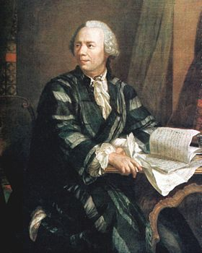
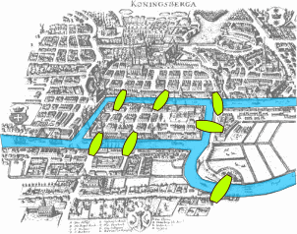
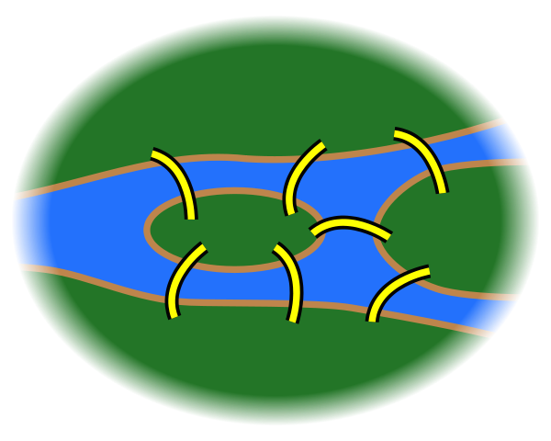
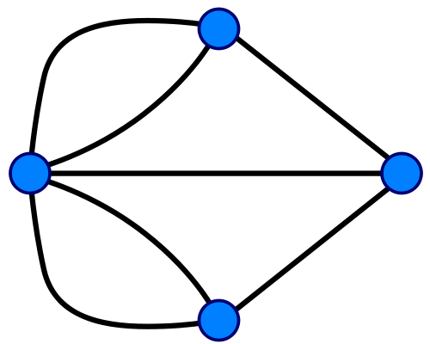
Network Analysis History
Network analysis originated many years ago.
In the 18th century Euler solved the famous Königsberg bridge problem.
Euler’s solution is considered to be the first theorem of network analysis and graph theory.

Slide 3
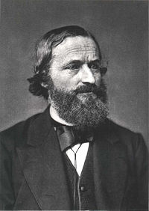
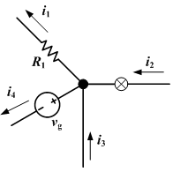
Network Analysis History
Network analysis originated many years ago.
In the 19th century Gustav Kirchhoff initiated the theory of electrical networks.
Kirchhoff was the first person who defined the flow conservation equations, one of the milestones of network flow theory.
After the invention of the telephone by Alexander Graham Bell in the 19th century the resulting applications gave the network analysis a great stimulus

Slide 4
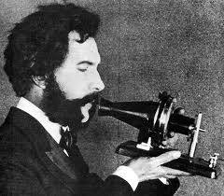
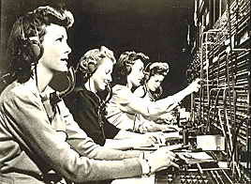
Network Analysis History
Network analysis originated many years ago.
In the nineteen century Gustav Kirchhoff initiated the theory of electrical networks.
Kirchhoff was the first person who define the flow conservation equations, one of the milestones of network flow theory.
After the invention of the telephone in the 19th century by Alexander Graham Bell, the resulting applications gave the network analysis a great stimulus.

Slide 5
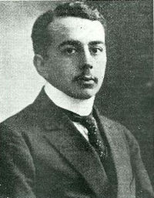

Network Analysis History
The field evolved dramatically after the 19th century.
The first graph theory book was written by Dénes König in 1936.
As in many other fields, WWII played a crucial role in the development of the field.
Many algorithms and techniques were developed to solve logistic problems from the military.
After the war, these technological advances were applied successfully in other fields.

Slide 6
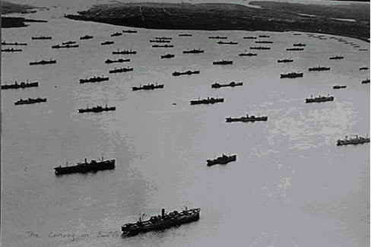
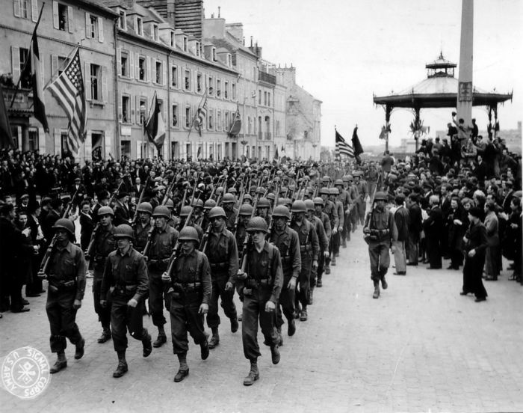
Network Analysis History
The field evolved dramatically after the 19th century.
The first graph theory book was written by Dénes König in 1936.
As in many other fields, WWII played a crucial role in the development of the field.
Many algorithms and techniques were developed to solve logistic problems from the military.
After the war, these technological advances were applied successfully in other fields.

Slide 7
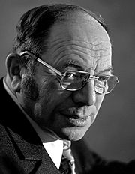
Network Analysis History
The field evolved dramatically after the 19th century.
The earliest linear programming model was developed by Leonid Kantorovich in 1939 during World War II, to plan expenditures to reduce the costs of the army.
In 1940, also during World War II, Tjalling Koopmans formulated also linear optimization models to select shipping routes to send commodities from America, to Specific destinations in England.
For their work in the theory of optimum allocation of resources, these two researchers were awarded with the Nobel price in Economics in 1975.

Slide 8
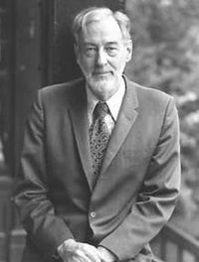
Network Analysis History
The field evolved dramatically after the 19th century.
The earliest linear programming model was developed by Leonid Kantorovich in 1939 during World War II, to plan expenditures to reduce the costs of the army.
In 1940, also during World War II, Tjalling Koopmans formulated also linear optimization models to select shipping routes to send commodities from America, to Specific destinations in England.
For their work in the theory of optimum allocation of resources, these two researchers were awarded with the Nobel price in Economics in 1975.

Slide 9
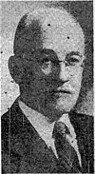
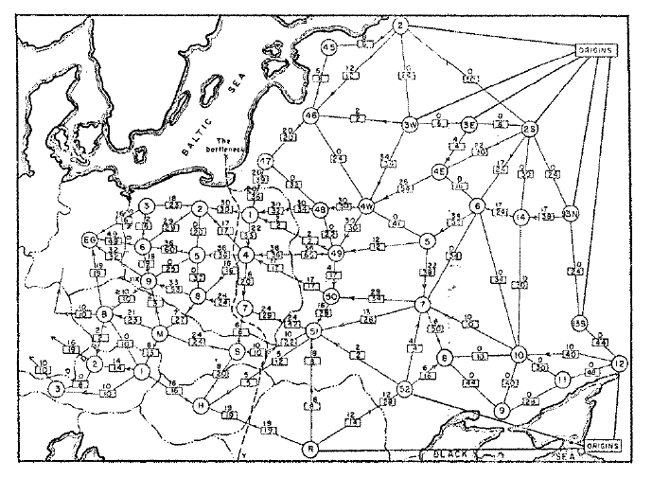
Network Analysis History
The field evolved dramatically after the 19th century.
The first complete algorithm for solving the transportation problem was proposed by Frank Lauren Hitchcock in 1941.
With the development of the Simplex Method for solving linear programs by George B. Dantzig in 1957, a new framework for solving several network problems became available.
The network simplex algorithm is still in practice one of the most efficient algorithms for solving network flow problems.

Slide 10
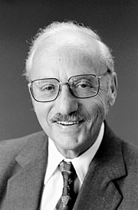
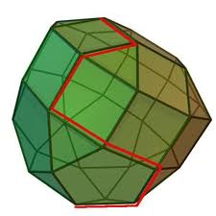
Network Analysis History
The field evolved dramatically after the 19th century.
The first complete algorithm for solving the transportation problem was proposed by Frank Lauren Hitchcock in 1941.
With the development of the Simplex Method for solving linear programs by George B. Dantzig in 1957, a new framework for solving several network problems became available.
The network simplex algorithm is still in practice one of the most efficient algorithms for solving network flow problems.

Slide 11
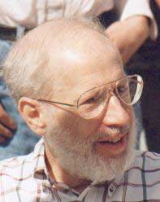
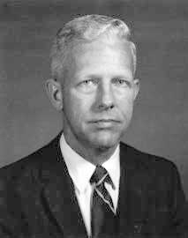
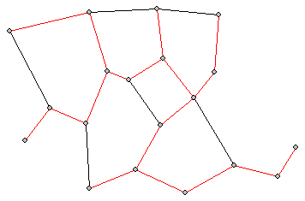
Network Analysis History
The field evolved dramatically after the 19th century.
Many other authors proposed efficient algorithms for solving different network problems.
Joseph Kruskal in 1956 and Robert C. Prim in 1957 developed algorithms for solving the minimum spanning tree problem.
In 1956 Edsger W. Dijkstra developed his algorithm for solving the shortest path problem, one of the most recognized algorithms in network analysis.

Slide 12

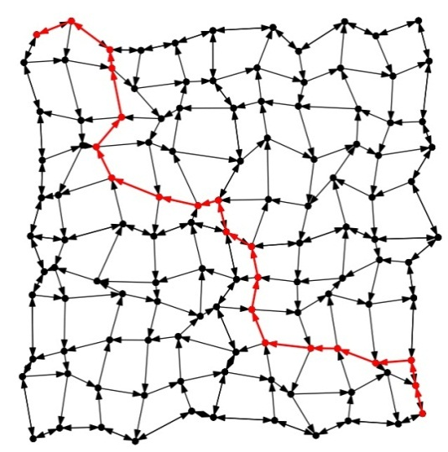
Network Analysis History
The field evolved dramatically after the 19th century.
Many other authors proposed efficient algorithms for solving different network problems.
Joseph Kruskal in 1956 and Robert C. Prim in 1957 developed algorithms for solving the minimum spanning tree problem.
In 1956 Edsger W. Dijkstra developed his algorithm for solving the shortest path problem, one of the most recognized algorithms in network analysis.

Slide 13

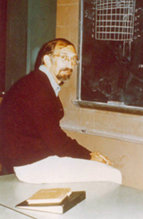
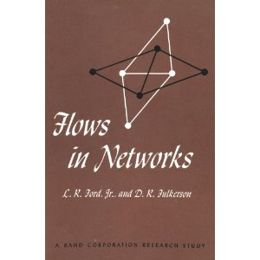
Network Analysis History
The field evolved dramatically after the 19th century.
As it happened in other fields, computer science and networks influenced each other in many aspects.
In 1963 the book by Lester R. Ford and Delbert R. Fulkerson introduced new developments in data structure techniques and computational complexity into the field of networks.

Slide 14
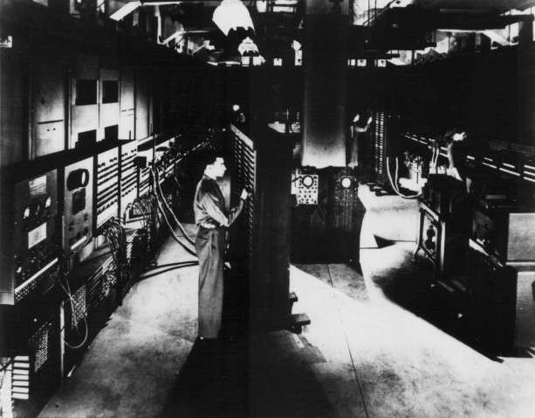

Network Analysis History
In recent years the evolution of computers have changed the field. We are now able to solve large-scale network problems.
Parallel computing
Grid computing
Cloud computing

Slide 15
Final Remarks and Motivations
Network Analysis has become a major research topic over the last years.
The broad range of applications that can be described and analyzed by means of a network is bringing together researches from numerous fields:
  Operations Research
  Computer Science
  Transportation
  Biomedicine
  Energy
  Social Sciences
  Computational Neuroscience
  Others.

Slide 16

Handbook of Combinatorial Optimization
Handbook of Combinatorial Optimization (2nd Edition) 2013, 4930 p. In 7 volumes Panos M. Pardalos, Ding-Zhu Du, and Ronald L. Graham (Eds.) http://www.springer.com/mathematics/book/978-1-4419-7996-4# 2013

Slide 17


Handbook of Optimization in Complex Networks
Theory and Applications My T. Thai and Panos M. Pardalos (Eds.) Springer. Series: Springer Optimization and Its Applications , 2012. Vol. 57. ISBN 978-1-4614-0753-9
Communications and Social Networks My T. Thai and Panos M. Pardalos (Eds.) Springer. Series: Springer Optimization and Its Applications , 2012. Vol. 58. ISBN 978-1-4614-0856-7

Slide 18

Handbook of Optimization in Complex Networks
Mathematical Aspects of Network Routing Optimization Carlos Oliveira and Panos M. Pardalos. Springer. Series: Springer Optimization and Its Applications , 2011. Vol. 53. ISBN 978-1-4614-0310-4

Slide 19


Handbook of Optimization in Complex Networks
Dynamics of Information Systems: Mathematical Foundations Alexey Sorokin, Robert Murphey, My T. Thai, and Panos M. Pardalos (Eds.) Springer. Springer Proceedings in Mathematics & Statistics, 2012. Vol. 20. ISBN 978-1-4614-3905-9
Dynamics of Information Systems: Algorithmic Approaches Alexey Sorokin, Robert Murphey, My T. Thai, and Panos M. Pardalos (Eds.) Springer. Springer Proceedings in Mathematics & Statistics. Forthcoming

Slide 20
Handbook of Optimization in Complex Networks
Dynamics of Information Systems: Mathematical Foundations Alexey Sorokin, Robert Murphey, My T. Thai, and Panos M. Pardalos (Eds.) Springer. Springer Proceedings in Mathematics & Statistics, 2012. Vol. 20. ISBN 978-1-4614-3905-9
Dynamics of Information Systems: Algorithmic Approaches Alexey Sorokin, Robert Murphey, My T. Thai, and Panos M. Pardalos (Eds.) Springer. Springer Proceedings in Mathematics & Statistics. Forthcoming

Slide 21
Graph Theory: Networks
A major step in graph theory was the development of the concept called “random graphs” by Erdos and Renyi**.
** Erdős, P., Rényi, A., 1959. On random graphs. Publ. Math. 6, 290–297.

Slide 22
Graph Theory: Networks
Another important step in graph theory was the development of an idea called “six degrees of freedom” by Frigyes Karinthy*.
A study conducted by Watts and Strogatz** presented the transition of a network from one extreme case “regular network” to another extreme case “random network”.
Their most interesting observation was the development of intermediate type of networks called “Small World Networks”.
*Milgram, S., 1967. The small-world problem. Psychol. Today 1, 61–67.
**Watts, D.J., Strogatz, S.H., 1998. Collective dynamics of “small-world" networks. Nature
393, 440–442.

Slide 23
Graph Theory: Networks
The results of study on three different types of network structures (regular, random and small world) tremendously increased the usage of network theory in solving real world problems.
One of the prominent usage of the network theory is in analyzing complex systems.

Slide 24
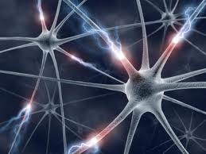

Network Models in Nature
Networks provide information on which system components interact with each other, putting aside the mechanisms of these interactions.
The dynamics of the system is tightly connected to the structure of the underlying network.
Studying the topological properties of system’s networks can provide an insight about the system’s high level structure and its function.

Slide 25
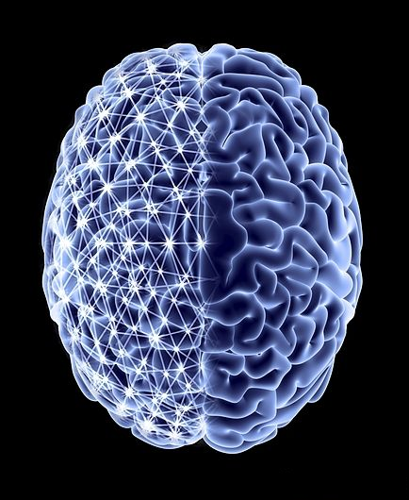
Brain Networks
The human brain is probably one of the most complex objects in nature.
Although the basic mechanism and function principle on single neuron level is understood, not much progress has been achieved in understanding global brain processes and functions.
The brain’s ability to gather and integrate information from numerous sources and generate responses is tightly connected to the complicated structure of its neural connections.

Slide 26
Brain Networks
Earlier studies of the brain function have focused mainly either on local or distributed properties.
Modern works shifted the attention to the structure and dynamics of large scale neuronal networks.
Studying neural activity on the high level of interaction patterns between large neuron populations and segregated anatomical regions may help to understand the fundamental laws of brain function.

Slide 27
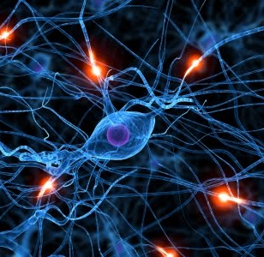
Structural Brain Networks
Most part of communication between nerve cells is performed through the physical connections. Sometimes these connections may link cells separated by a long distances.
By quantitative estimations, the human cerebral cortex contains roughly 8 x 10⁹ neurons and 7 x 10¹³ connections.
Having this tremendous number of connections, brain networks remain very sparse with a fraction of present connections of around 10⁻⁶.

Slide 28
Structural Brain Networks
It turns out that these sparse brain networks are not random, but have special structure patterns.
Neurons tend to connect mainly to the neighbor neurons forming local groups, and thus local connectivity in neural networks is much higher, than it would be expected in random networks.
At the same time there is certain number of consistent "long range" connections between distant areas.
Multiple studies have shown, that topology of brain networks at different scales has small world attributes.

Slide 29
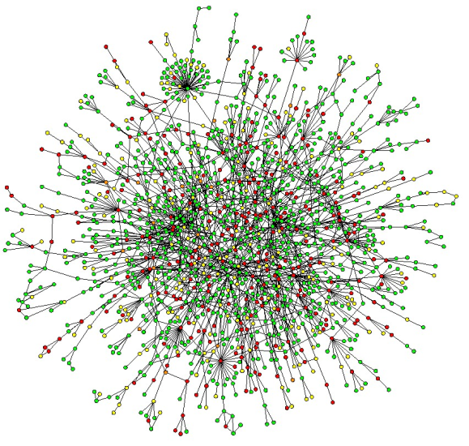
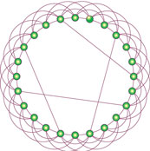
Small World Networks
It has been found that many complex networks in nature (or man-made) follow common organizational principles.
These networks are densely connected on the local (neighborhood) level, but at the same time have certain number of "long range" connections linking nodes, which otherwise would be far apart.
These networks are called Small World Networks.

Slide 30

Quantitative Measures of “small world” Property
Let N be a number of nodes in the graph G.
Denote d_{ij} a shortest path from node i to node j.
Let G_{i} be a subgraph of G, containing nodes, adjacent to node i. Let k_{i} and e_{i} be a number of nodes and a number of connections in G_{i} respectively. The local clustering coefficient C_{i} is defined, as

Slide 31









Quantitative Measures of “small world” Property
Characteristic path length
Clustering coefficient
Network efficiency

Slide 32
Structural Brain Networks
Structural connectivity refers to the set of physical connections linking neurons in brain.
Small world properties were reported in mammalian and human brain structural networks (representing physical neural connections) at all levels of scales, starting from single neuron level to large anatomical regions containing millions of neurons.

Slide 33
Structural Brain Networks
On the single neuron level, Humphries et. al. have shown that the neural system of the medial reticular formation of the brainstem is a small world system.
The neural system of a worm C. elegans is the only neural system which was mapped completely at the level of neurons and synapses; and it was shown to exhibit small world properties.
Human brain networks were shown to be small worlds at different level of scale, starting from brain regions of several millimeters to large anatomical areas containing millions of neurons.

Slide 34
Occasional Phenomena or Natural Property?
Consistent findings in different mammalian species and human suggest that small world structure comprises fundamental principles in organization and evolution of neural networks.
Economical properties of small world networks may give an explanation to this fact.
Small world networks are shown to be efficient in information transfer at both global and local levels, and at the same time resilient to errors and damages.
In light of this, one can argue that neural networks may have developed small world topology during the evolution process.

Slide 35
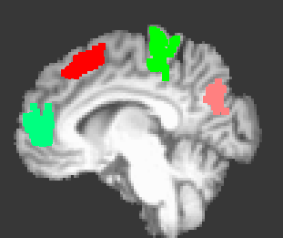
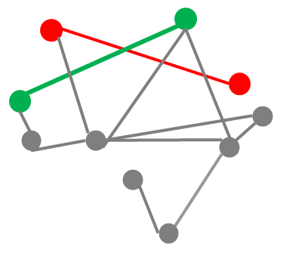
Functional Brain Networks
Another important aspect of brain function is its neural activity and dynamics. Neural activity can be modeled as a network, which is widely known as functional connectivity brain network.
The connections in functional network are defined not by physical paths in the brain, but by statistical dependencies between neural signals in distinct parts of the brain.
Such temporal dependencies are assumed to be the result of neuronal interaction along anatomical connections.

Slide 36
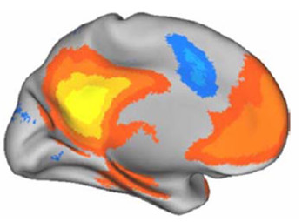
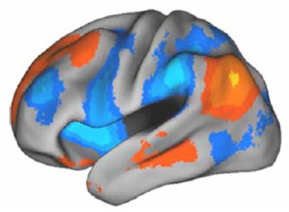
Functional Brain Networks
It is commonly recognized that in resting human brain, there exists a consistent functional network between cortical brain regions (widely known as default mode network).
It has been proposed, that functional networks form a physiological basis for information processing and mental cognition.

Slide 37
Relation: Structural and Functional Networks
Patterns of neural activity are defined and shaped by neural connectivity, and functional networks in large part resemble structural brain networks.
Functional networks can tell us more about processes in the brain then simple map of physical neural connections.
Certain brain areas, which are not connected directly, communicate with each other through other areas, and these communications are reflected in the functional network.
Functional network comprises structural network, but also contains connections between those areas which are not connected in structural network, but link to each other dynamically, exhibiting related neural activity.

Slide 38
Applications
We focus our attention on two major cases:
  Network analysis in Parkinson brain
    The goal is to classify healthy and Parkinson patients based on the functional network structure of their brain.
    We use fMRI data to analyze the brain network.
  Network analysis in Epileptic brain
    The goal is to study the changes in epileptic brain network at pre-ictal, ictal and post-ictal stage of seizure.
    We use EEG data to analyze the brain network.

Slide 39
Parkinson Brain Network

Slide 40
Framework
The main idea is to extract the concealed information from brain data, to distinguish a healthy subject from a Parkinson patient.
The data collected from the brain, for the above mentioned classification, is in the form of brain images, commonly known as fMRI.
In order to compare results (from different patients and controls), we have used standard template from Montréal Neurological Institute (MNI).

Slide 41
Complexities
Noise is inevitable in any data collection method. fMRI data suffers from the noise too.
Noise filtering is a crucial step before the actual analysis.
We have used discrete wavelet transform to remove noise from the data.

Slide 42
Brain Network Analysis in PD fMRI Data
We have analyzed fMRI data in 15 healthy controls and 14 Parkinson (PD) patients .
The networks were constructed from functional Magnetic Resonance Imaging (fMRI) data recordings.
Small world properties, in particular network efficiency, were studied in obtained networks.

Slide 43


Magnetic Resonance Imaging
Blood flow level as an indicator of neuronal activity.
Representation of values of signal in spatial voxels as 2D and 3D images.

Slide 44
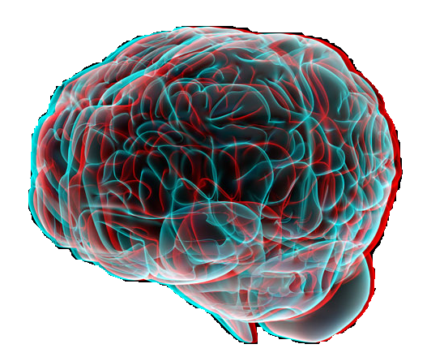







fMRI Data
Z
(x, y, z)
X
0
Y

Slide 45


Defining Nodes
In order to define nodes in the network we have used the MNI brain template which partitions the brain into 116 anatomical regions.
Each node in the network corresponds to one of the regions.

Slide 46
Defining Edges
For each patient we have constructed weighted graph with nodes corresponding to MNI brain regions.
Weights of edges defined based on wavelet correlation between averaged neural activity over the regions.

Slide 47
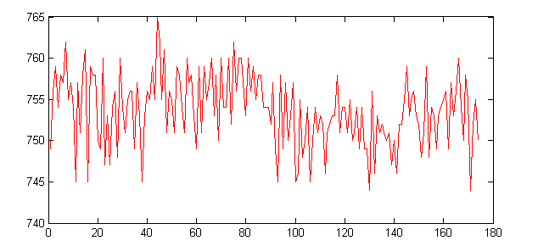
Signal Processing
Apart from neural activity fMRI signals contain other non neural sources of correlation, such as:
  Head movements during the MR session
  Respiratory and heart rhythms
  Other sources of noise

Slide 48
Why Wavelet Transform?
It has been shown that inter-regional correlations in resting state fMRI data are particularly salient at frequencies below 0.1 Hz, while most of the non neural sources of signal belong to higher frequency bands.*
Wavelet transform allows to decompose signal into components at different frequency bands.
Unlike classical Fourier transform, wavelet transform coefficients are localized both in time and frequency domains and allow to better describe finite time series with sharp pikes which is the case in brain fMRI time series.
* Salvador R, Suckling J, Schwarzbauer C, Bullmore ET (2005) Undirected graphs of frequency-dependent functional connectivity in whole brain networks. Philos T Roy Soc B 360: 937–946.

Slide 49
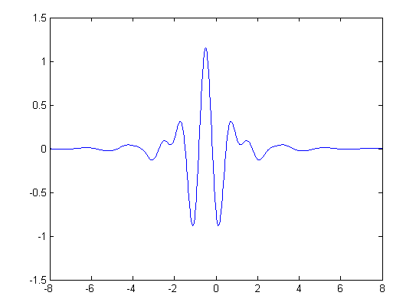
Background: Wavelet Transform
Wavelet is a “small wave” i.e. a function which grows and
decays in a limited time period.
Wavelet transform is a decomposition of initial signal into linear combination of wavelets.

Slide 50


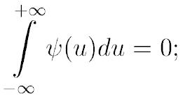
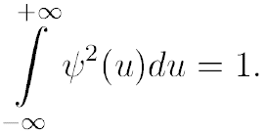


Background: Continuous Wavelet Transform
Strictly speaking a wavelet is any function defined over the which satisfies following two conditions:
A continuous wavelet transform of function f at scale translated by is defined as:

Slide 51


Background: Discrete Wavelet Transform
In practice when dealing with finite time series a discrete wavelet transform (DWT) is used. It approximates the integral on the previous slide with finite series of the form:
here – discrete time points, – wavelet
coefficients.

Slide 52




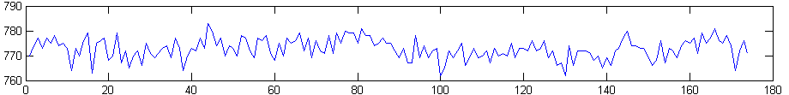
Time Series Decomposition by Wavelets
Smooth component
Third level detail
wavelet coefficients
Second level detail
wavelet coefficients
First level detail
wavelet coefficients
Initial signal

Slide 53
Analysis
Using DWT we have decomposed initial fMRI signal into components at several frequency ranges (each components is described by vector of wavelet coefficients of corresponding level)
We have studied pairwise correlations between wavelet coefficient vectors derived from fMRI signals in different anatomical brain regions
The most significant findings were obtained in level 2 wavelet coefficients, which correspond 0.06 – 0.12 Hz frequency range
As a result a complete weighted graph was obtained, were nodes correspond to brain regions, and weights of connections defined based on wavelet correlations.
We wished to study sparse networks composed of strongest, most significant connections. In every network we kept 10% of strongest connections and the rest of connections were discarded. Further analysis was performed on these sparse weighted networks.

Slide 54
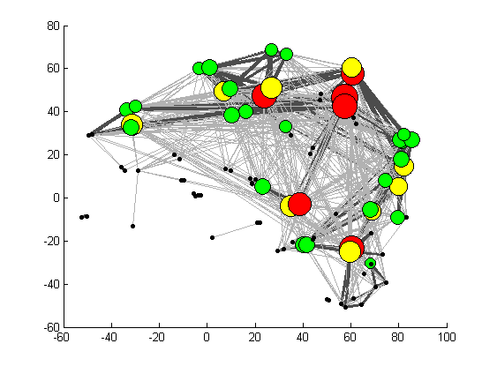
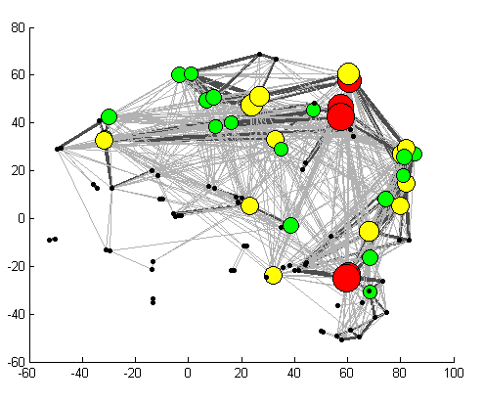
Connectivity
The color and size represents node degree.
Control
Parkinson

Slide 55
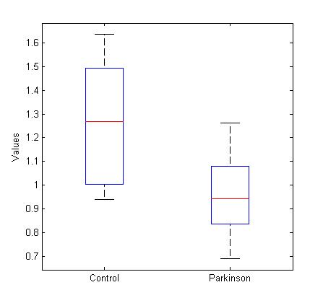
Global Network Efficiency in PD & Healthy Controls
Based on the constructed networks we have computed network efficiency in every patient.
It turned out that the efficiency of patients with PD on an average is lower than the efficiency of healthy controls; and the difference across samples is statistically significant.
Control (1.25 ± 0.25), Parkinson (0.95 ± 0.17), independent t-test
p-value = 0.0008

Slide 56
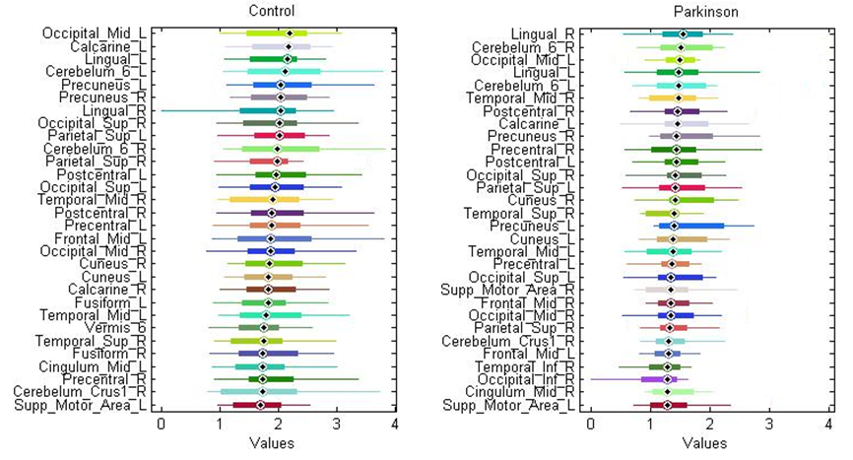
Nodal Network Efficiencies
The differences in efficiency were observed also on local level at particular regions.

Slide 57
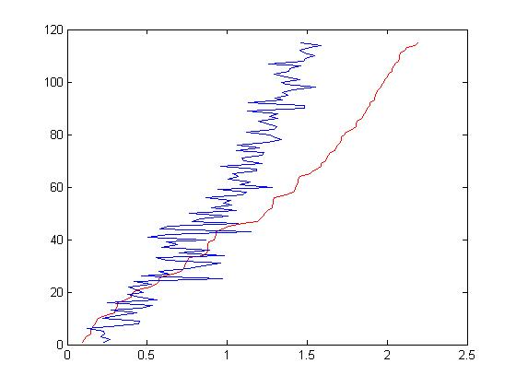
Average Efficiency Decrement Across All Nodes
We have computed efficiency decrement across all brain regions.
The slop of efficiency versus node index in PD patients was lower than that in healthy controls.
This suggests that in PD patients, the diversity between activity in brain areas is degraded. Areas which are normally most active exhibit neural activity of similar level to the low-active ones.
Control (red line, slop = 0.019 ± 0.009),
Parkinson (blue line, slop = 0.011 ± 0.007), independent t-test
p-value = 0.01

Slide 58
Reference
F. Skidmore, D. Korenkevych, Y. Liu, G. He, E. Bullmore, P. M. Pardalos, Connectivity brain networks based on wavelet correlation analysis in Parkinson fMRI data, Neuroscience Letters, Vol. 499, Issue 1, 15 July 2011, Pages 47-51.
D. Korenkevych, J. Chien, J. Zhang, D. Shiau, J. C. Sackellares, P. M. Pardalos,
Small world networks in computational neuroscience, in Handbook
on Combinatorial Optimization, Springer.

Slide 59
Epileptic Brain Network

Slide 60
Background of PNES
Psychogenic NonEpileptic Seizures(PNES) are paroxysmal episodes that resemble and often misdiagnosed as epileptic seizures; however, PNES are psychological in origin.
About 25% of the patients visiting epilepsy centers were diagnosed as PNES patients*.
About 20% of PNES patients have both epileptic seizures and PNES**. Most PNES patients are epileptic seizure-free.
*Witgert ME, Wheless JW, Breier JI. Frequency of panic symptoms in psychogenic nonepileptic seizures. Epilepsy Behav 2005;6:174–8.
**Benbadis SR, Agrawal V, Tatum WO. How many patients with psychogenic nonepileptic seizures also have epilepsy? Neurology 2001;57:915–7.

Slide 61
Background of CPS
Complex Partial Seizures (CPS) are epileptic seizures that are originated from one cerebral hemisphere and cause the impairment of awareness or consciousness.
CPS occur in about 35% of epileptic patients.

Slide 62
Significance
For an Epilepsy Monitoring Unit (EMU) subject to be identified as an epileptic or PNES patient, the EEG recordings have to contain the presences of ictal patterns or epileptiform discharges.
Due to the uncertain presences of ictal patterns or epileptiform discharges, the EEG recording usually has to continue for a long period of time so that the recording can possess some presences of ictal patterns.
This study probes the possibility of identifying CPS and PNES patients using only a certain amount of interictal EEG recordings.

Slide 63
Incidence of Epileptic Seizure Types
Hauser WA, Seizure Disorders: The Changes With Age, Epilepsia. 33(Suppl. 4):S6-S14, 1992

Slide 64
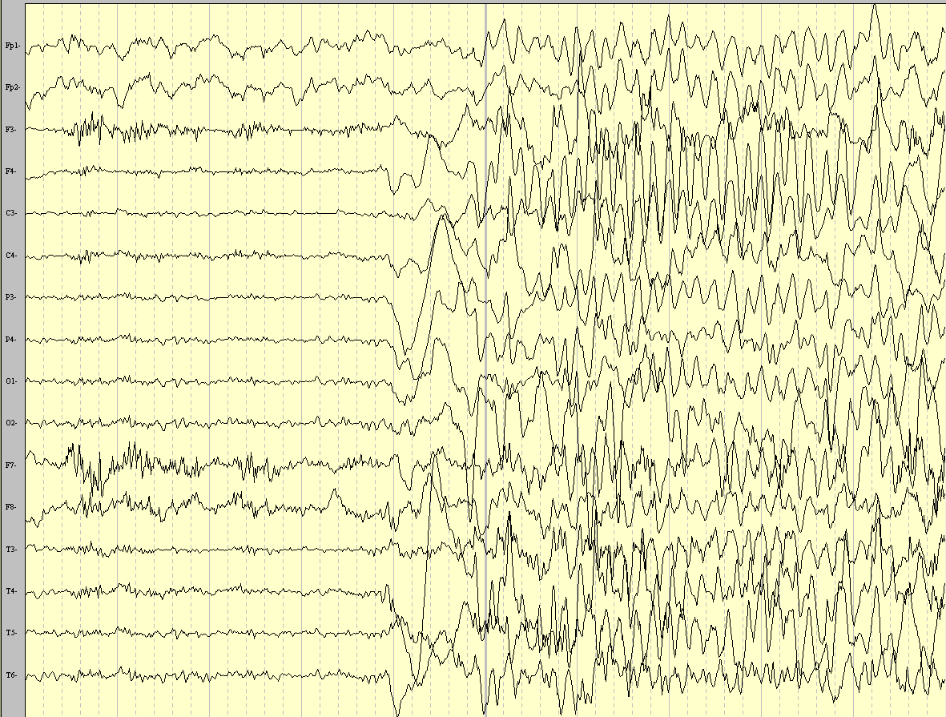
Ictal EEG of a Convulsive PNES

Slide 65
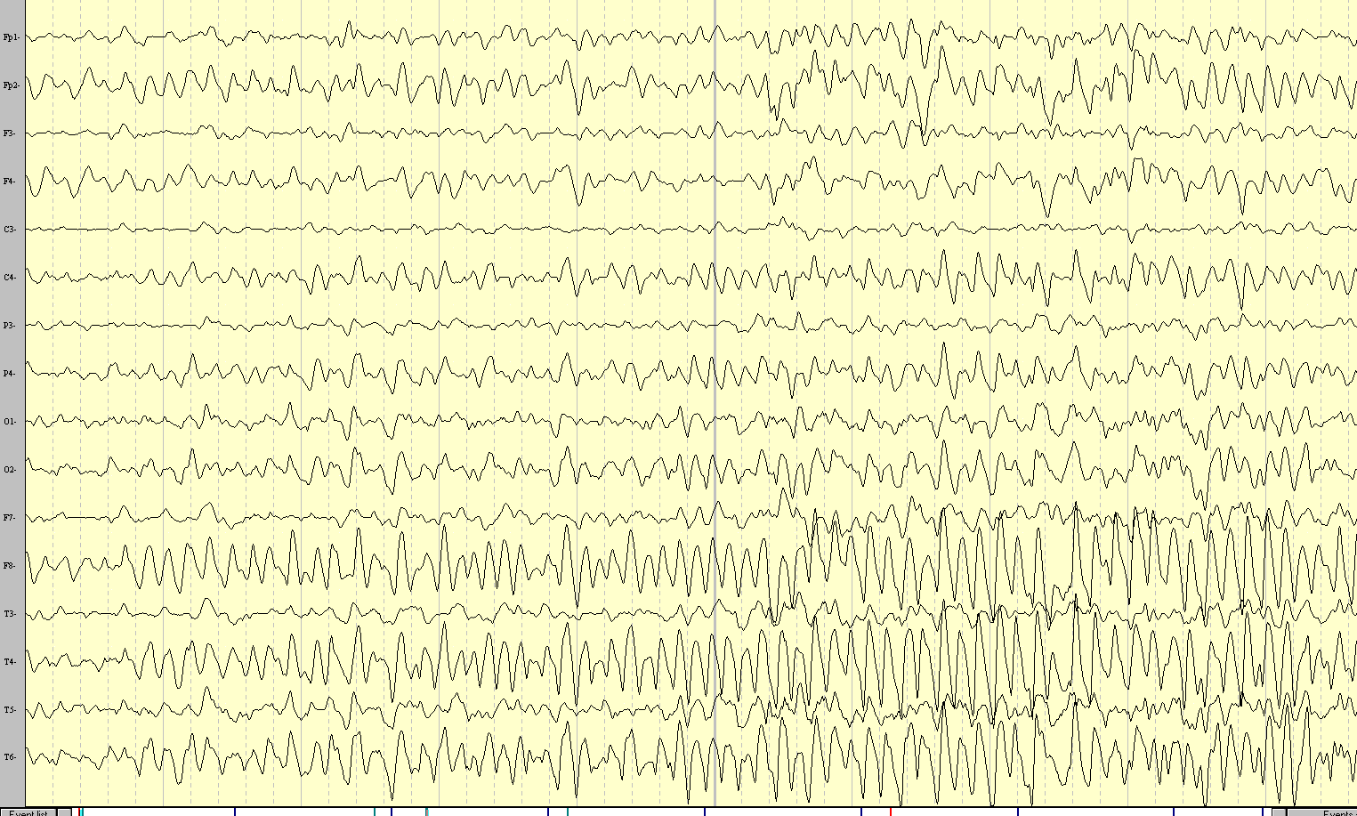
Ictal EEG of a Complex Partial Seizure

Slide 66
Data Collection Method
The study included seven CPS patients and another seven PNES patients.
Drowsy state EEG signals are characterized by dominant alpha oscillation around O1 and O2 channels and no eye-blinking activities.
Eyes-closed resting state EEG sub-segments of subjects were selected from long-term EEG recordings.
All selected eyes-closed resting state EEG sub-segments are at least seven hours before the first CPS or PNES.
Subjects have at least four continuous eyes-closed resting state segments. These segments are all longer than 30 seconds.

Slide 67
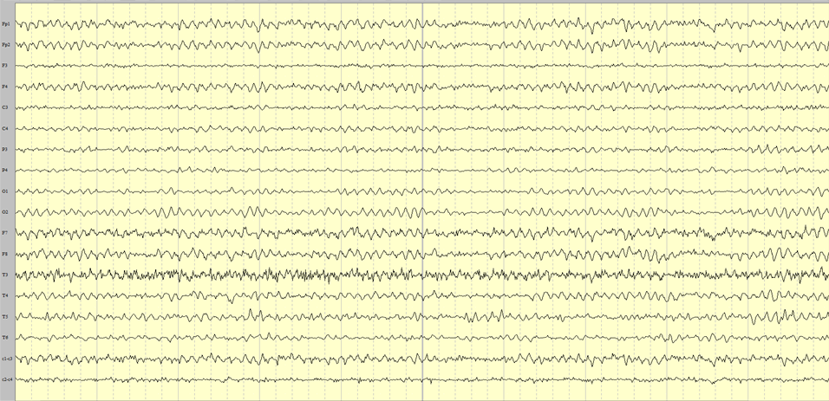
Drowsy State EEG of a CPS Patient

Slide 68
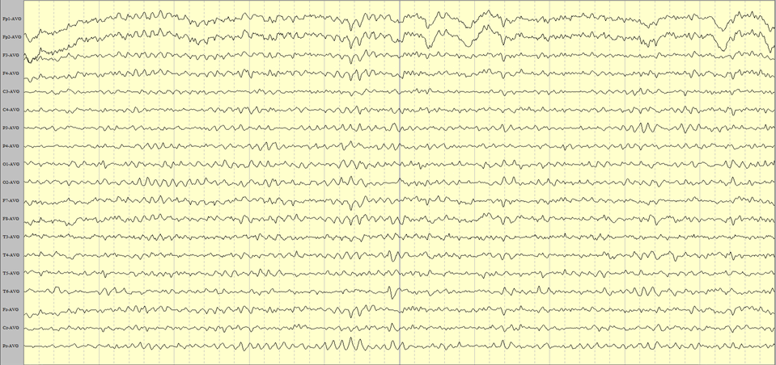
Drowsy State EEG of a PNES Patient

Slide 69
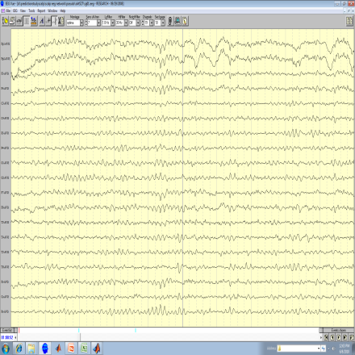
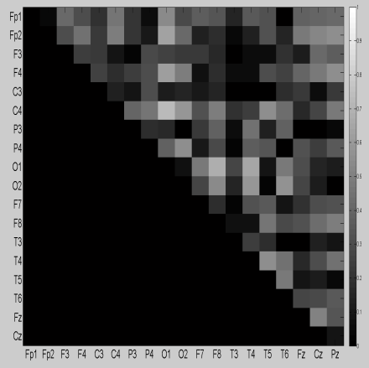



Small World Network Analysis Flow
Phase lag index
Apply a threshold
Characteristic path lengths
Lp
Cp
Randomize the graph
Lp/<Ls>
Small-world network index
Cp/<Cs>
Cp/<Cs>
λ =
Lp/<Ls>
Ls
Cs
Visualization of a graph
Clustering coefficients
Notes:
Change line color

Slide 70

Significance of the Existence of Small World Structure

Slide 71

Network Measure Results

Slide 72
Reference
Chaovalitwongse W, Iasemidis LD, Pardalos PM, Carney PR, Shiau DS, Sackellares JC. Performance of a seizure warning algorithm based on the dynamics of intracranial EEG. Epilepsy Research 2005; 64: 93-113.
Iasemidis LD, Shiau DS, Sackellares JC, Pardalos PM, Prasad A. Dynamical resetting of the human brain at epileptic seizures: Application of nonlinear dynamics and global optimization techniques. IEEE Transactions on Biomedical Engineering 2004; 51: 493-506.
Prokopyev OA, Boginski V, Chaovalitwongse W, Pardalos PM, Sackellares JC, Carney PR. Network-based techniques in EEG data analysis and epileptic brain modeling. Data Mining in Biomedicine 2003; 7: 559-73.
W. A. Chaovalitwongse, P.M. Pardalos, and P. Xanthopoulos, editors. Computational Neuroscience. Springer, 2010.

Slide 73
Emerging Questions

Slide 74
Network Controllability
In nearly every study conducted on human brain networks the questions asked were what are the hubs of the network, e.g. the nodes with highest degree?
There is however another important network characteristic set of nodes, arising from network controllability theory, which for the time being remained beyond the attention of researchers

Slide 75


Network Controllability
Assume that vector
captures the state of a network of n nodes at time t, and
satisfies the equation
Here matrix A describes network connections diagram, matrix
B is the input matrix that identifies nodes controlled by outside
controller. The network is controlled using input vector u(t).
A network described above is called controllable if it can be driven from any initial state to any desired final state in finite time.

Slide 76
Network Controllability
The nodes to which the control is applied are called driver nodes of the network. The question arising here can formulated as following: identify a minimum set of driver nodes, providing controllability of the network
It has been shown, that the minimum set of driver nodes is tightly connected to a maximum matching on the network
More precisely, we gain full control over network if and only if we control each unmatched node and there are directed paths from these nodes to all matched nodes.

Slide 77
Drivers of Brain
It has been shown, that in majority of real and artificial networks the hubs (nodes with high number of connections) are not among the minimum set of driver nodes
Currently we are asking a question, what are the drivers of the brain? Since past studies were focused mostly on network hubs, which in general are not network drivers, answer to this question may bring new and interesting results about human brain

Slide 78
Dynamics of Brain
Another fundamental question to ask is, How does the brain connectivity change over the time.
What should be the appropriate measure (or minimal set of measures) that will completely describe the dynamics of brain?

Slide 79
Selected books
Sustainable Interdependent Networks, co-editors: Amini, M.H., Boroojeni, K.G., Iyengrar, S.S., Pardalos, P.M., Blaabjerg, F., Madni, A.M., Springer, (2018).

Slide 80
Selected books
Smart City Networks - Through the Internet of Things, Editors: Rassia, Stamatina Th., Pardalos, Panos M., Springer Optimization and Its Applications, volume 125 (2017).

Slide 81
Selected books
Optimization and Management in Manufacturing Engineering, co-authors: Xinbao Liu, Jun Pei, Lin Liu, Hao Cheng, Mi Zhou, Panos M. Pardalos, Springer, (2017).

Slide 82
Selected books
Dynamics of Information Systems: Computational and Mathematical Challenges, coeditors: C. Vogiatzis, J. L. Walteros and P. M. Pardalos, Springer, (2014).

Slide 83
Thank You

