Slide 1




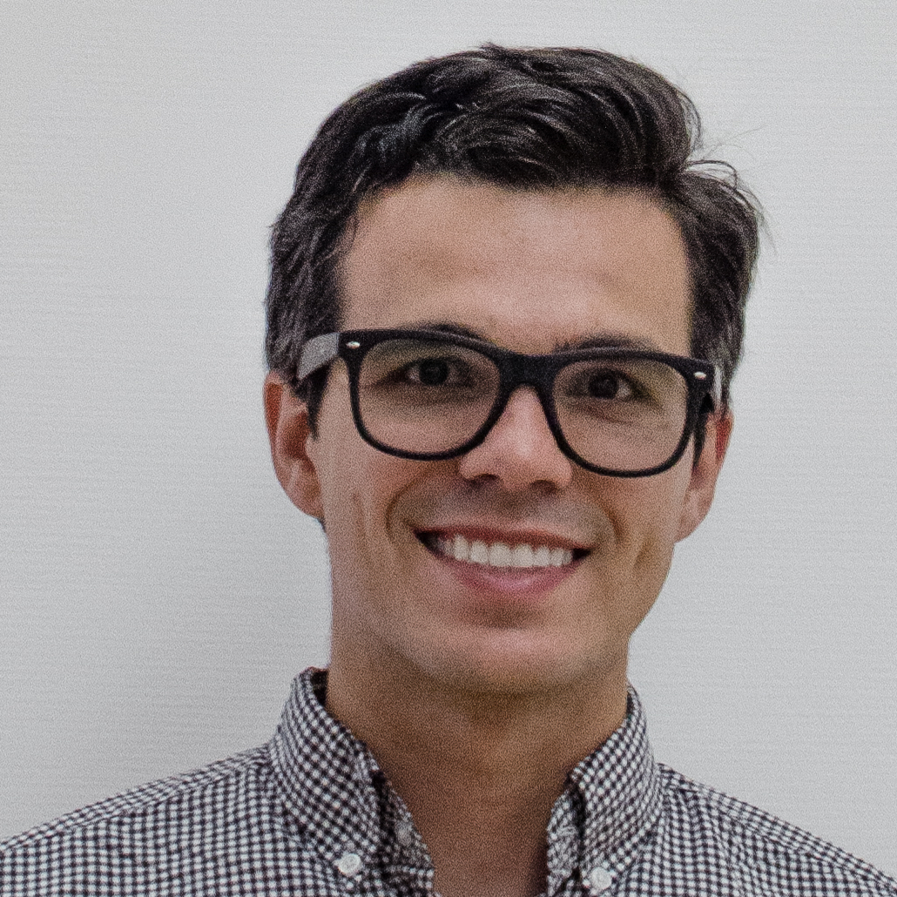

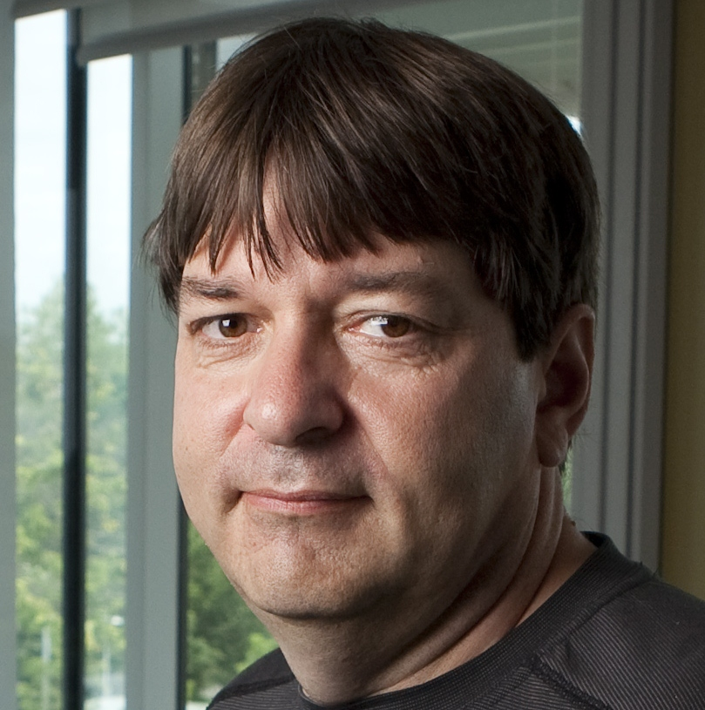

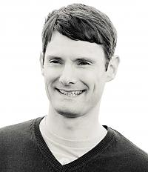
Extending the frontiers of deep learning using probabilistic modelling
James Requeima*
University of Cambridge,
Invenia Labs
Jonathan Gordon*
University of Cambridge
John Bronskill*
University of Cambridge
Sebastian Nowozin
Google Research
Berlin
Richard E. Turner
University of Cambridge,
Microsoft Research
[1] Requeima, J., Gordon, J. and Bronskill, J., Nowozin, S. and Turner, R.E. " Fast and Flexible Multi-Task Classification Using Conditional Neural
Adaptive Processes.” arXiv preprint arXiv:1906.07697 (2019). *Authors contributed equally.

Slide 2
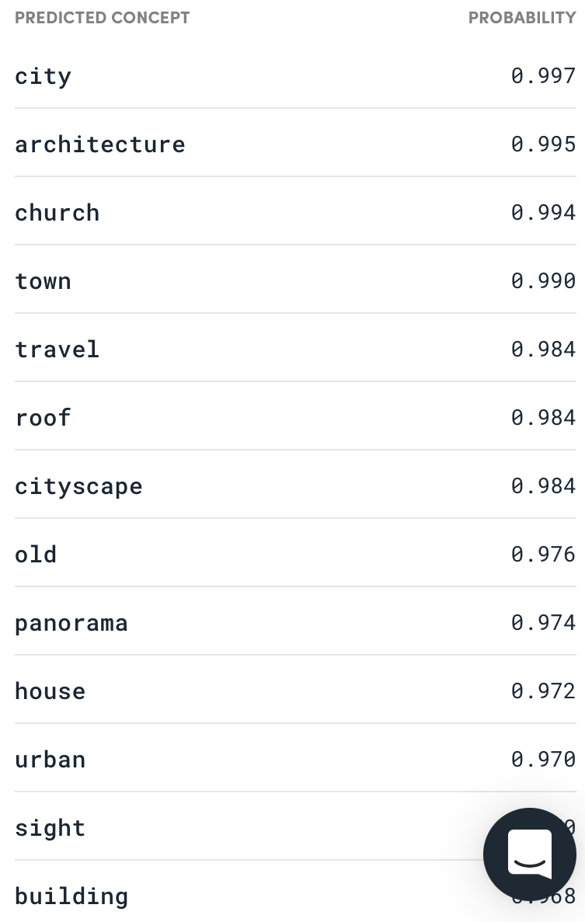
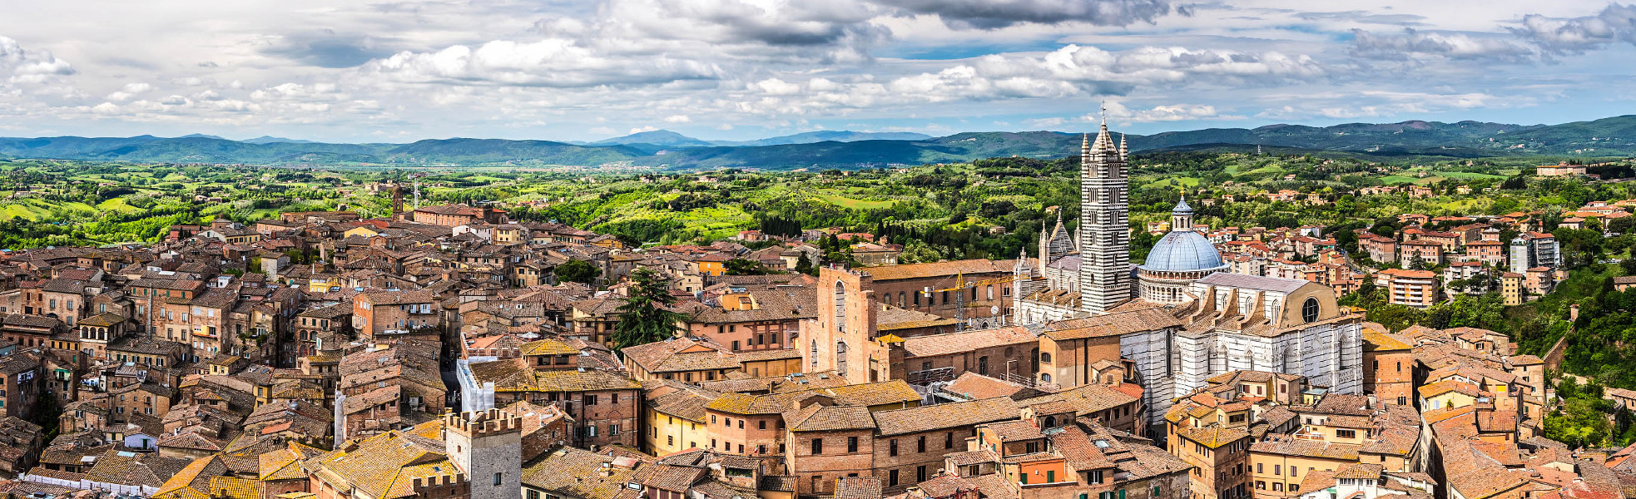
please upload an image…

Slide 3
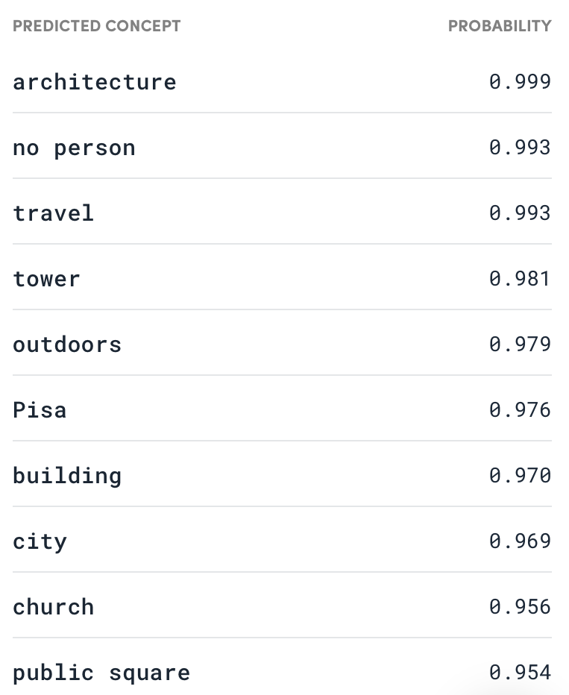
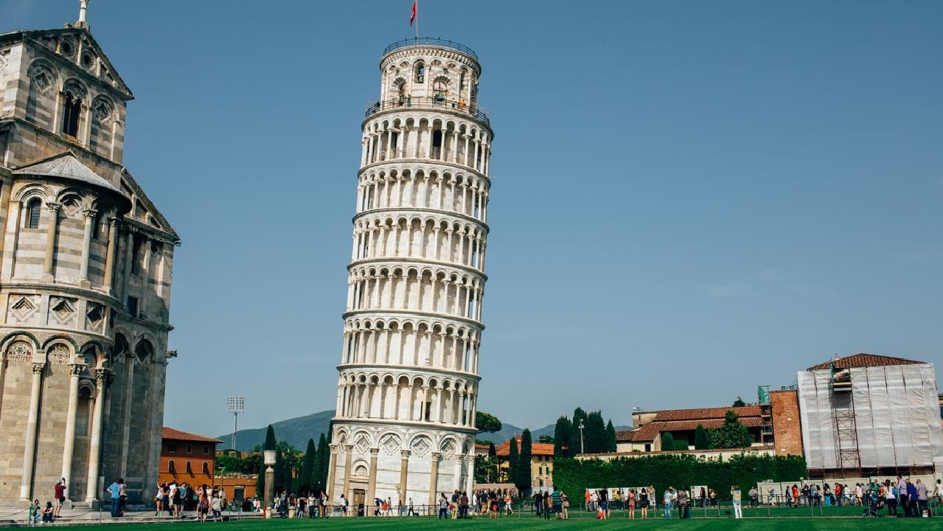
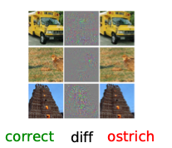
deep learning is often confidently wrong
please upload an image…
deep learning
is not robust
e.g. when testing
conditions do
not match
training
conditions

Slide 4
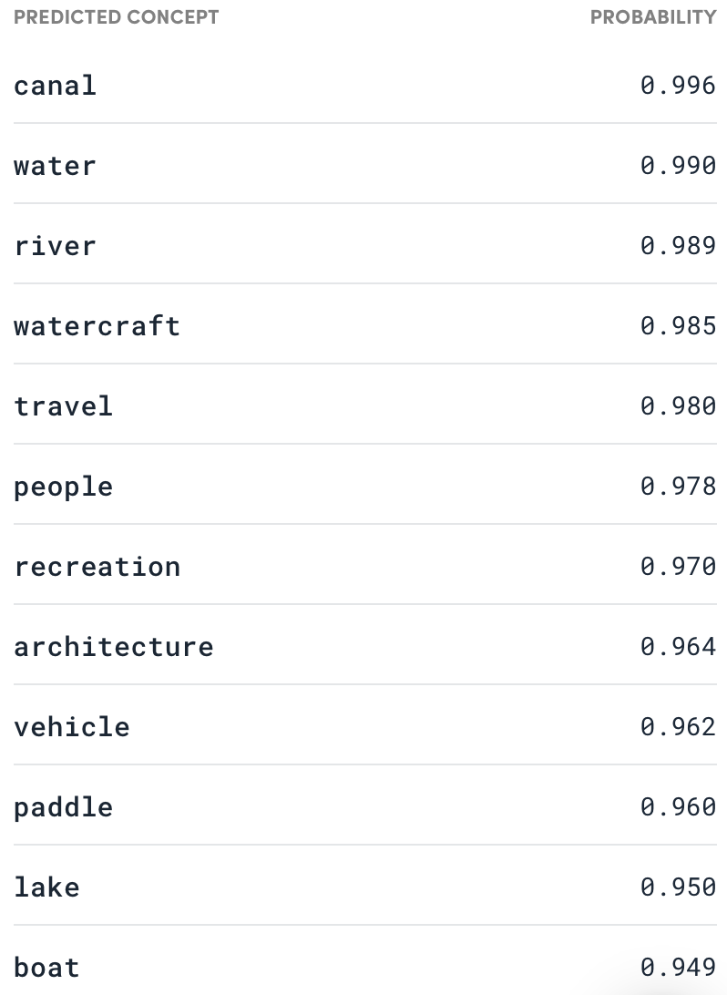

To add new class ‘punt’ requires:
many labelled images of punts
retraining system from scratch
deep learning is data inefficient and does not support continual learning
please upload an image…

Slide 5
Four Key Problems with the Deep Learning Toolkit
What are the Limitations of Deep Learning?
Uncertainties poorly calibrated: often confidently wrong
Fragile: perform poorly when test conditions do not match training conditions e.g. adversarial examples
Continual learning unsupported: retrain from scratch or catastrophically forget
Small-data: cannot handle small data (few-shot learning)
These limitations are critical in applications such as healthcare, autonomous systems,
environmental science, personalisation, resource allocation etc.

Slide 6
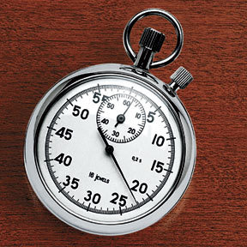
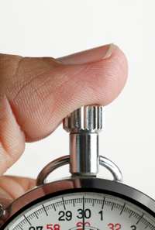
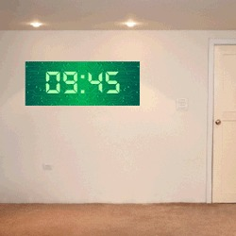
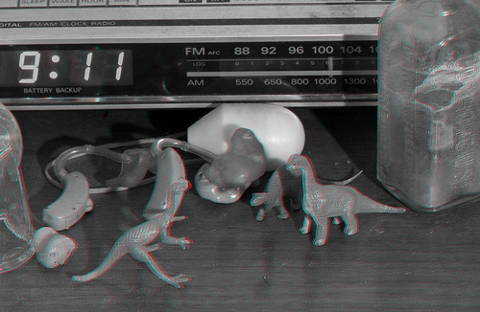
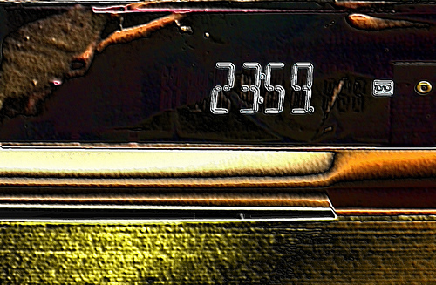
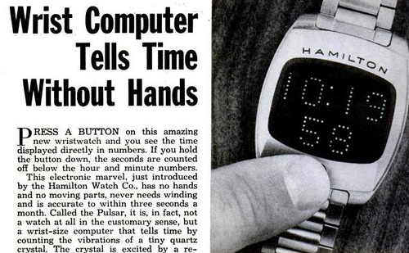
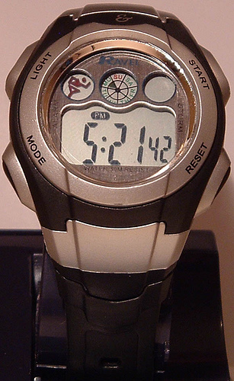

Training Images
Stop Watch
Digital Clock
Digital Watch
Parking Meter

Slide 7

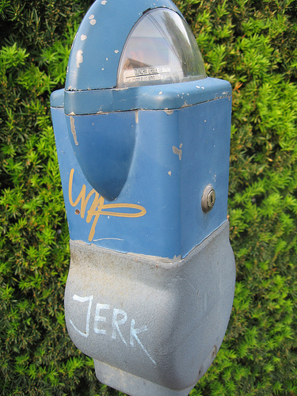
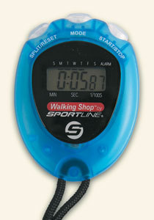
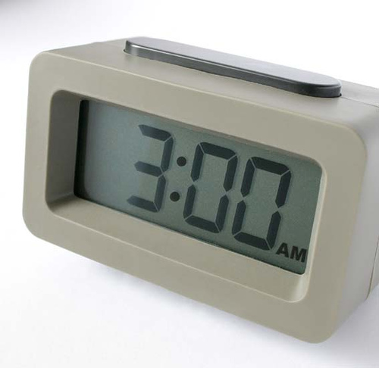
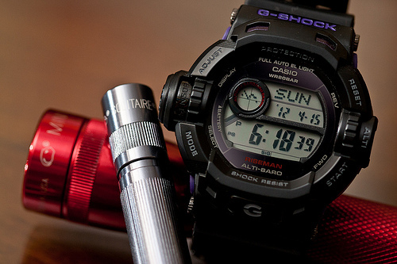
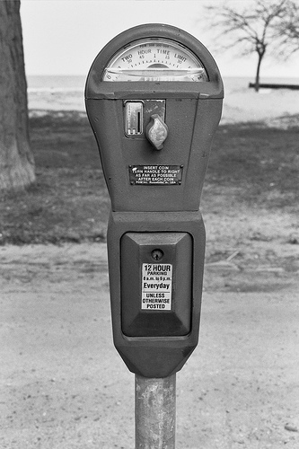
Training Images
 | 0.65 | 0.1 | 0.2 | 0.2
 | 0.1 | 0.65 | 0.05 | 0.05
 | 0.25 | 0.2 | 0.65 | 0.05
 | 0 | 0.05 | 0.1 | 0.7
Stop Watch
Digital Clock
Digital Watch
Parking Meter
Testing Images

Slide 8
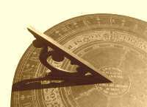
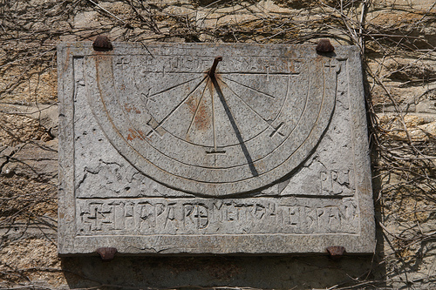
Training Images
 | 0.65 | 0.1 | 0.2 | 0.2 | 0.05
 | 0.1 | 0.7 | 0.1 | 0.05 | 0.05
 | 0.2 | 0.2 | 0.6 | 0.05 | 0.05
 | 0.04 | 0 | 0.05 | 0.6 | 0.05
 | 0.01 | 0 | 0.05 | 0.1 | 0.8
Stop Watch
Digital Clock
Digital Watch
Parking Meter
Sundial
Testing Images

Slide 9
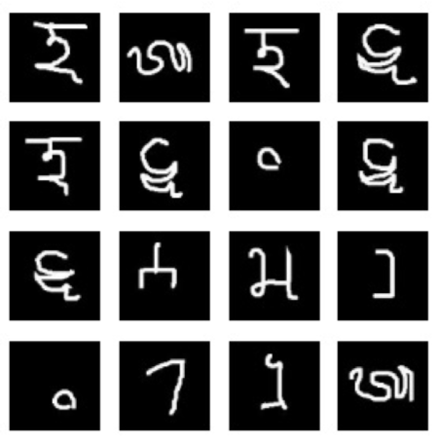
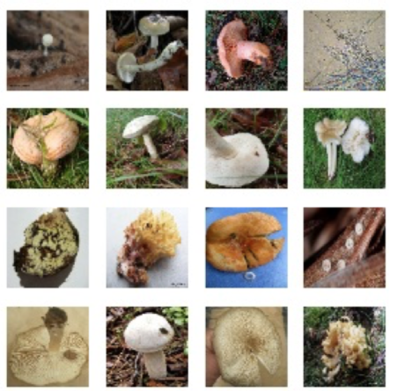
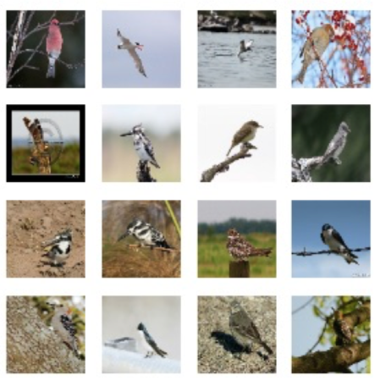
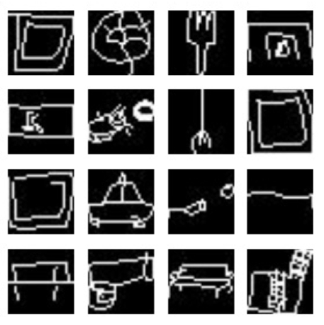
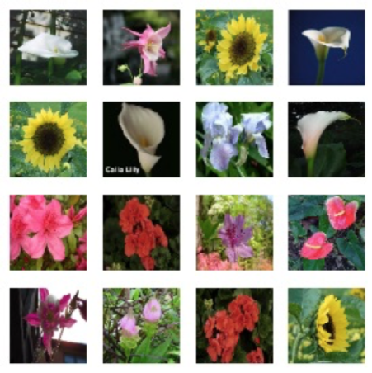
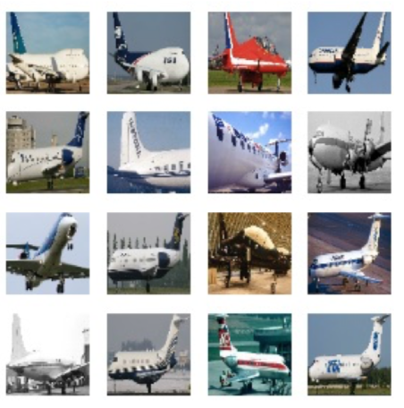
Leveraging related data sets: multi-task learning
Transfer
1. features
2. how to adapt
to new tasks
few-shot dataset
contains new classes;
potentially new domain
many data sets / tasks

Slide 10
Deep Learning Approaches: old and new
= task
Traditional multi-task modelling approach:
New approach: directly specify the predictive distribution
Relates to Conditional Neural Processes [1] and neural auto-regressive models
Train by maximum likelihood.
= global parameters
= task specific params
Train task specific parameters on task data giving
Predict using:
[1] Garnelo, Marta, et al. "Conditional neural processes." arXiv preprint arXiv:1807.01613 (2018).

Slide 11

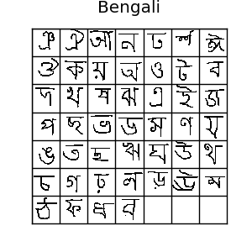
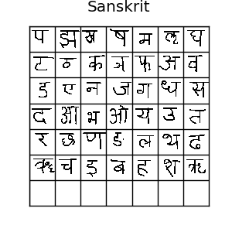
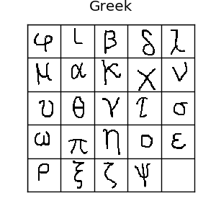
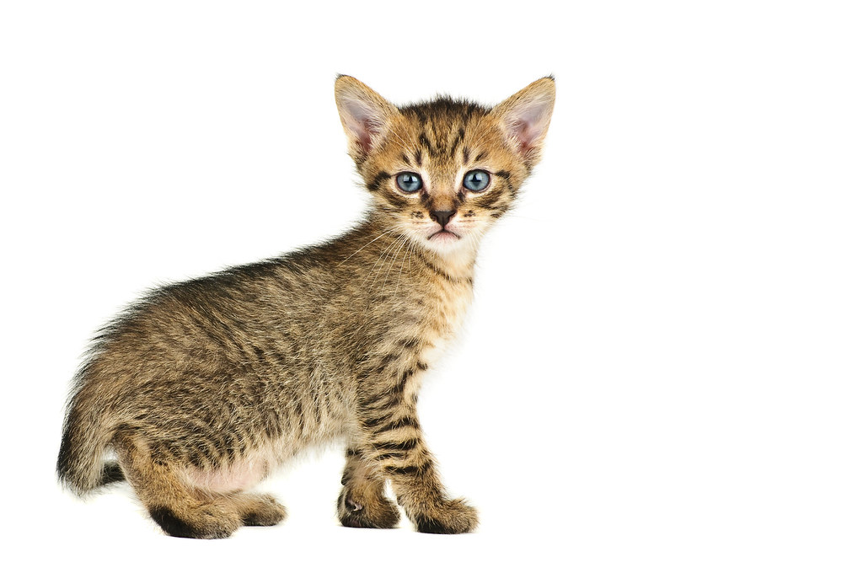
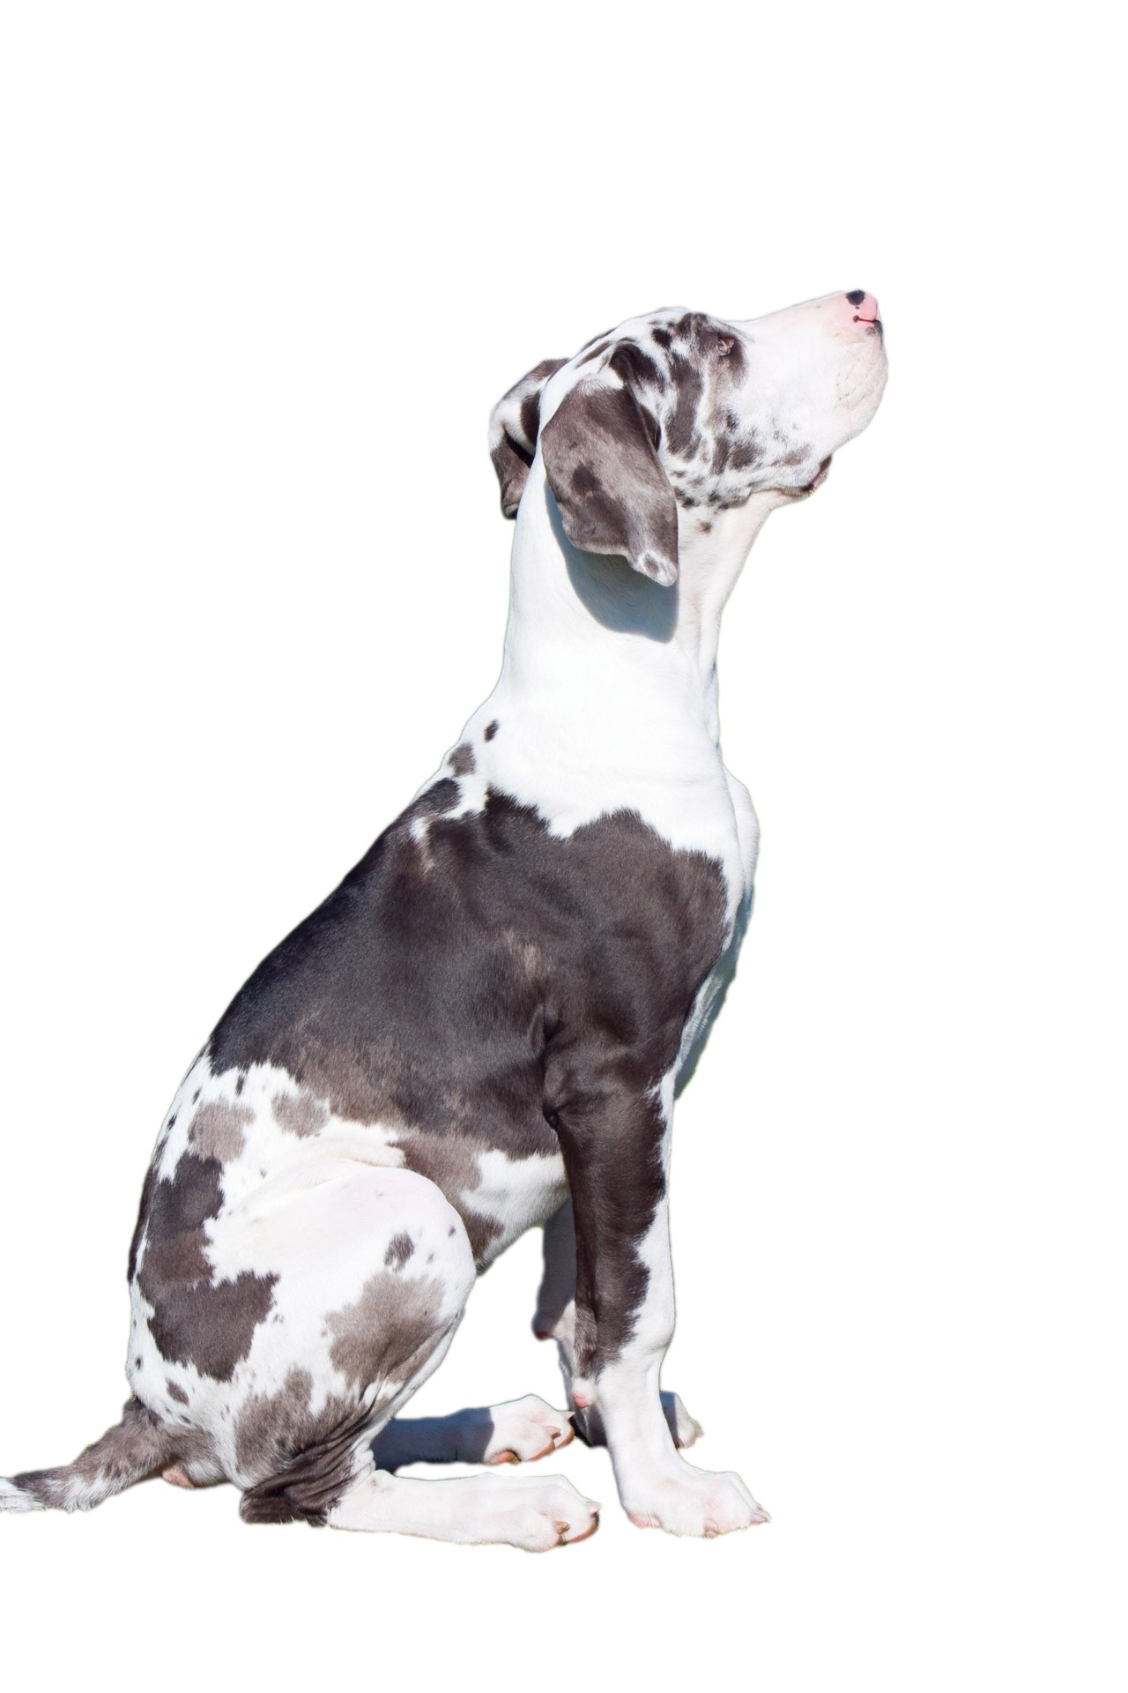
Task specific parameters: adapting a classifier
Input
Feature Extractor
Linear Classifier
Output
Weights
Biases
CAT
adapt feature extractor
(very different types of
input image)
different head for each task
(different classes and numbers
of classes in each task)
Bengali
Sanskrit
Greek

Slide 12
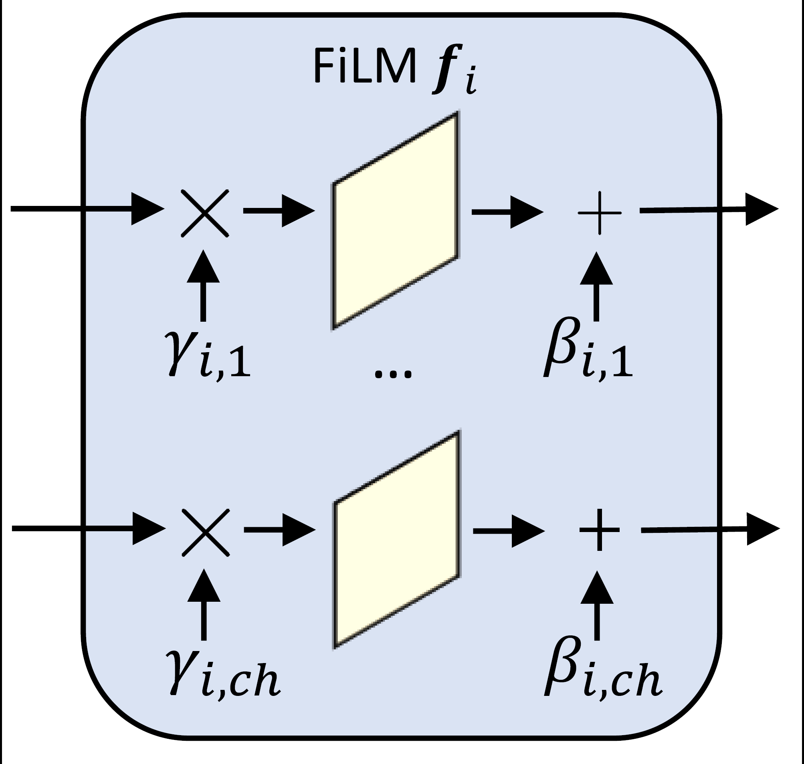


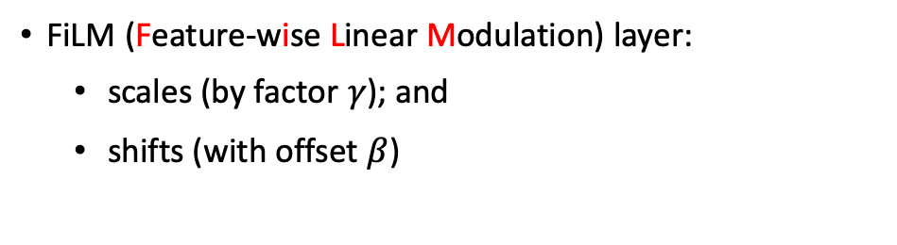




Adapting the feature extractor: FiLM layers^{[1]}
FiLM (Feature-wise Linear Modulation) layer:
  scales (by factor $γ$); and
  shifts (with offset $β$)
When added to a ResNet block:
  enable expressive feature adaptation
  add a small number of parameters (< 1% of the system).
Input
Feature Extractor
Linear Classifier
Output
$$F$$
$$F$$
$$F$$
$$F$$
Weights
Biases
$$θ$$
$$θ$$
$$θ$$
$$θ$$
CAT
[1] Perez, Ethan, et al. "Film: Visual reasoning with a general conditioning layer.” Thirty-Second AAAI Conference on Artificial Intelligence. 2018.

Slide 13

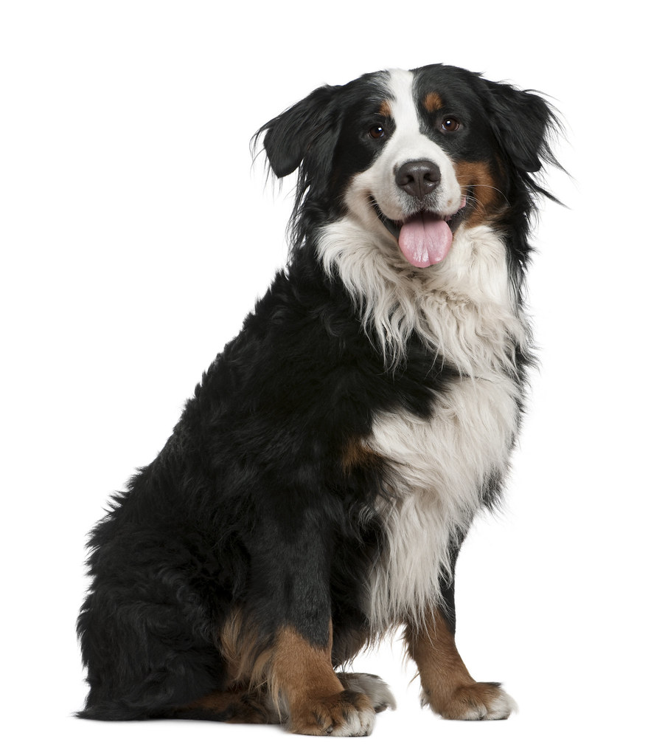

Feature Extractor Adaptation Network
PointNet / DeepSets / statistics network
Continual learning supported by running averages
Feature Extractor Adaptation Network
Task context set $D^{τ}$
Input
Feature Extractor
Linear Classifier
Output
$$F$$
$$F$$
$$F$$
$$F$$
Weights
Biases
$$θ$$
$$θ$$
$$θ$$
$$θ$$
CAT

Slide 14










Feature Extractor Adaptation Network
pass context set through feature extractor class by class
features for each class $c$ are summed (a la PointNet / DeepSets)
head adaptation network generates the weights and biases for class $c$
Feature Extractor Adaptation Network
Head Adaptation Network
Task context set $D^{τ}$
Input
Feature Extractor
Linear Classifier
Output
$$F$$
$$F$$
$$F$$
$$F$$
Weights
$$b_{1}$$
$$θ$$
$$θ$$
$$θ$$
$$θ$$
Biases
…
$$w_{1}$$
…
…
$$b_{c}$$
CAT
$$w_{c}$$
$$w_{C}$$
…
$$b_{C}$$

Slide 15
Classifier Head Adaptation Network
pass context set through feature extractor class by class
features for each class $c$ are summed (a la PointNet / DeepSets)
head adaptation network generates the weights and biases for class $c$
Feature Extractor Adaptation Network
Head Adaptation Network
Task context set $D^{τ}$
Input
Feature Extractor
Linear Classifier
Output
$$F$$
$$F$$
$$F$$
$$F$$
Weights
$$b_{1}$$
$$θ$$
$$θ$$
$$θ$$
$$θ$$
Biases
…
$$w_{1}$$
…
…
$$b_{c}$$
CAT
$$w_{c}$$
$$w_{C}$$
…
$$b_{C}$$

Slide 16
Summary of CNAPs
Use context set to adapt feature extractor FiLM layers
Pass context set class by class through adapted feature extractor and generate head
1
2
Feature Extractor Adaptation Network
Head Adaptation Network
Task context set $D^{τ}$
Feature Extractor
Linear Classifier
$$F$$
$$F$$
$$F$$
$$F$$
Weights
$$b_{1}$$
$$θ$$
$$θ$$
$$θ$$
$$θ$$
Biases
…
$$w_{1}$$
…
…
$$b_{c}$$
$$w_{c}$$
$$w_{C}$$
…
$$b_{C}$$

Slide 17
Summary of CNAPs
Use context set to adapt feature extractor FiLM layers
Pass context set class by class through adapted feature extractor and generate head
Apply adapted network to test examples
1
2
Feature Extractor Adaptation Network
Head Adaptation Network
Task context set $D^{τ}$
Input
Feature Extractor
Linear Classifier
Output
$$F$$
$$F$$
$$F$$
$$F$$
Weights
$$b_{1}$$
$$θ$$
$$θ$$
$$θ$$
$$θ$$
Biases
3
…
$$w_{1}$$
…
…
$$b_{c}$$
CAT
$$w_{c}$$
$$w_{C}$$
…
$$b_{C}$$

Slide 18
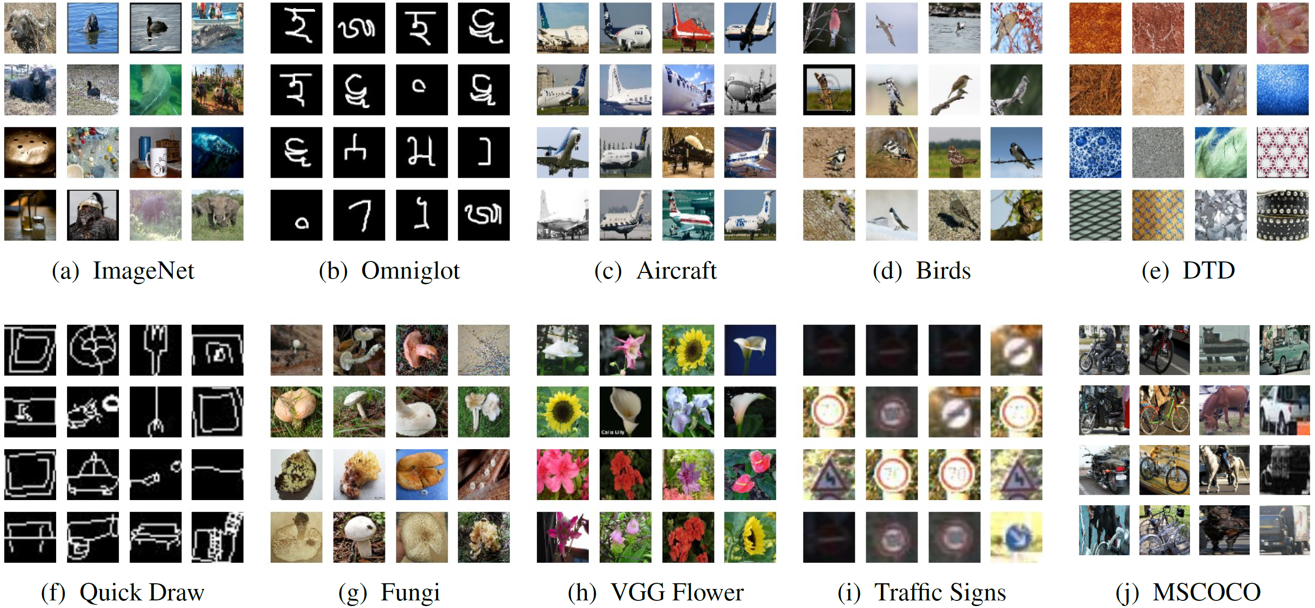
Meta-Dataset^{[1]} Multi-task, Few-shot Benchmark
ImageNet
OmniGlot
Aircraft
Birds
DTD
Quick Draw
Fungi
VGG Flower
Traffic Signs
MSCOCO
entirely held out
[1] Eleni, et al. "Meta-dataset: A dataset of datasets for learning to learn from few examples.“
Very Challenging. Comprised of 10 large and diverse datasets.
8 are used for training, Traffic Signs and MSCOCO are entirely held out.
Test set classes always differ from the training set classes.

Slide 19
Training Images
Stop Watch
Digital Clock
Digital Watch
Parking Meter

Slide 20

Training Images
 | 0.69 | 0.02 | 0.07 | 0.24
 | 0.04 | 0.13 | 0.11 | 0.32
 | 0.27 | 0.85 | 0.80 | 0.35
 | 0 | 0.01 | 0.02 | 0.10
Stop Watch
Digital Clock
Digital Watch
Parking Meter
Testing Images

Slide 21
Training Images
 | 0.63 | 0.02 | 0.04 | 0.11
 | 0.04 | 0.09 | 0.13 | 0.11
 | 0.29 | 0.70 | 0.61 | 0.24
 | 0.04 | 0.19 | 0.22 | 0.54
Stop Watch
Digital Clock
Digital Watch
Parking Meter
Testing Images

Slide 22
Training Images
 | 0.81 | 0.04 | 0.07 | 0.11 | 0.11
 | 0.01 | 0.12 | 0.09 | 0.12 | 0.16
 | 0.08 | 0.68 | 0.72 | 0.12 | 0.13
 | 0.02 | 0.16 | 0.12 | 0.54 | 0.12
 | 0.07 | 0 | 0 | 0.12 | 0.47
Stop Watch
Digital Clock
Digital Watch
Parking Meter
Sundial
Testing Images

Slide 23
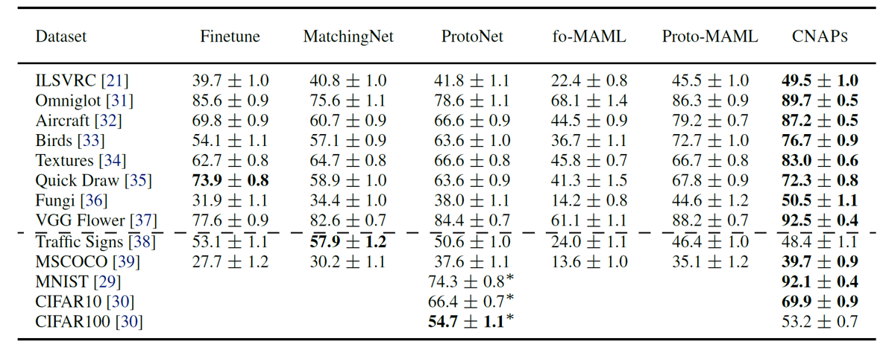
Meta-Dataset Few-Shot Classification Results
held
out
classes
entirely
held
out

Slide 24
Continual Learning Results: Single head, CIFAR 100
80
RWalk 500-shot
60
Accuracy
40
20
10
20
30
40
50
60
70
80
90
100
CIFAR10
Number of classes
CIFAR100

Slide 25
Continual Learning Results: Single head, CIFAR 100
80
RWalk 500-shot
CNAPs 10-shot
60
Accuracy
40
20
10
20
30
40
50
60
70
80
90
100
CIFAR10
Number of classes
CIFAR100

Slide 26
Continual Learning Results: Single head, CIFAR 100
80
RWalk 500-shot
CNAPs 10-shot
60
CNAPs 100-shot
Accuracy
40
20
10
20
30
40
50
60
70
80
90
100
CIFAR10
Number of classes
CIFAR100

Slide 27
Active Learning

Slide 28
Conditional Adaptive Neural Processes (CNAPs)
Leverage multiple related datasets (multi-task / meta-learning)
Very data efficient (supports few shot learning)
Naturally supports continual learning
Robust: handles test conditions which differ from training conditions
Has well-calibrated uncertainties e.g. supports active learning
Bonus features:
performs learning at test time very quickly (just a forward pass through a network; no backpropagation)
Can extend to handle parameter uncertainty (meta-learn probabilistic inference)

Slide 29
References
Requeima, J., Gordon, J. and Bronskill, J., Nowozin, S. and Turner, R.E.
Fast and Flexible Multi-Task Classification Using Conditional Neural
Adaptive Processes. NeurIPS (2019).
https://arxiv.org/abs/1906.07697
Gordon, J. and Bronskill, Bauer, M., J., Nowozin, S. and Turner, R.E.
Meta Learning Probabilistic Inference for Prediction. ICLR (2019).
https://arxiv.org/abs/1805.09921

Slide 30
Speed of learning new tasks at test time

Slide 31
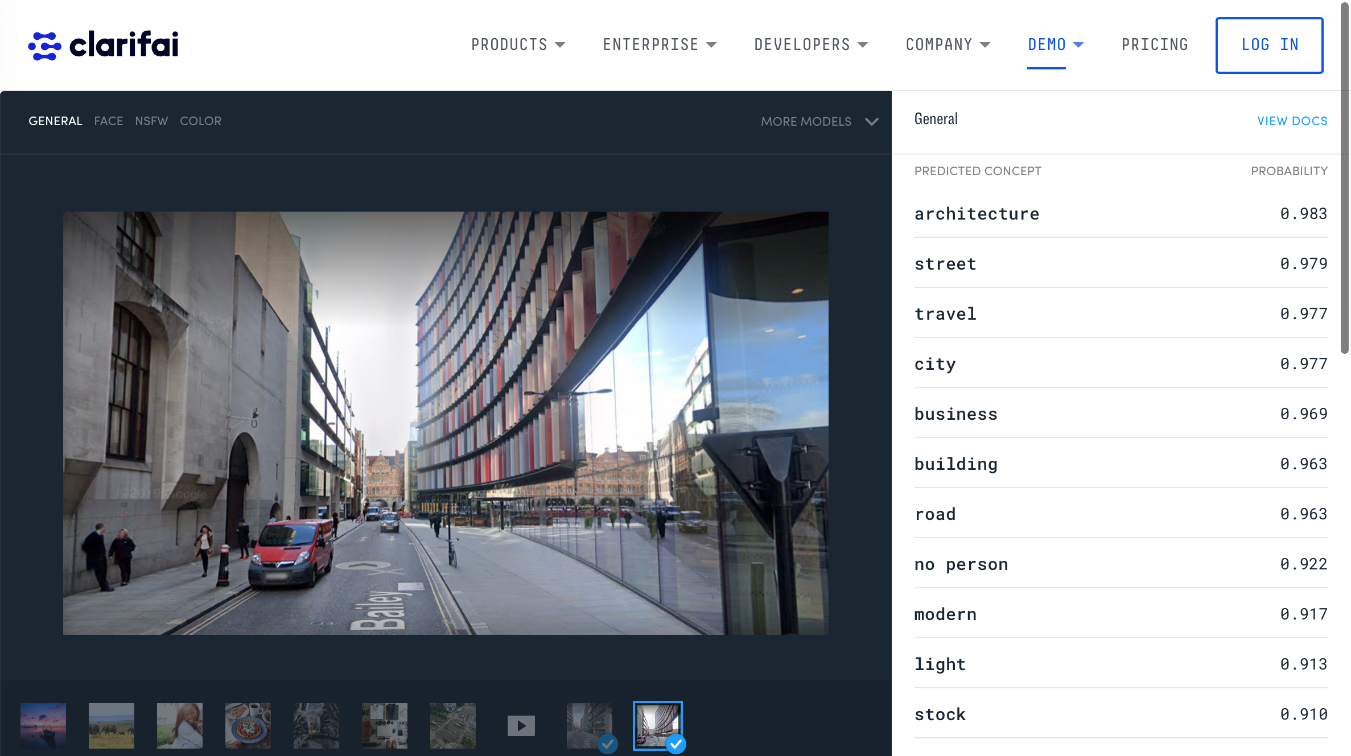

Slide 32
please upload an image…

Slide 33
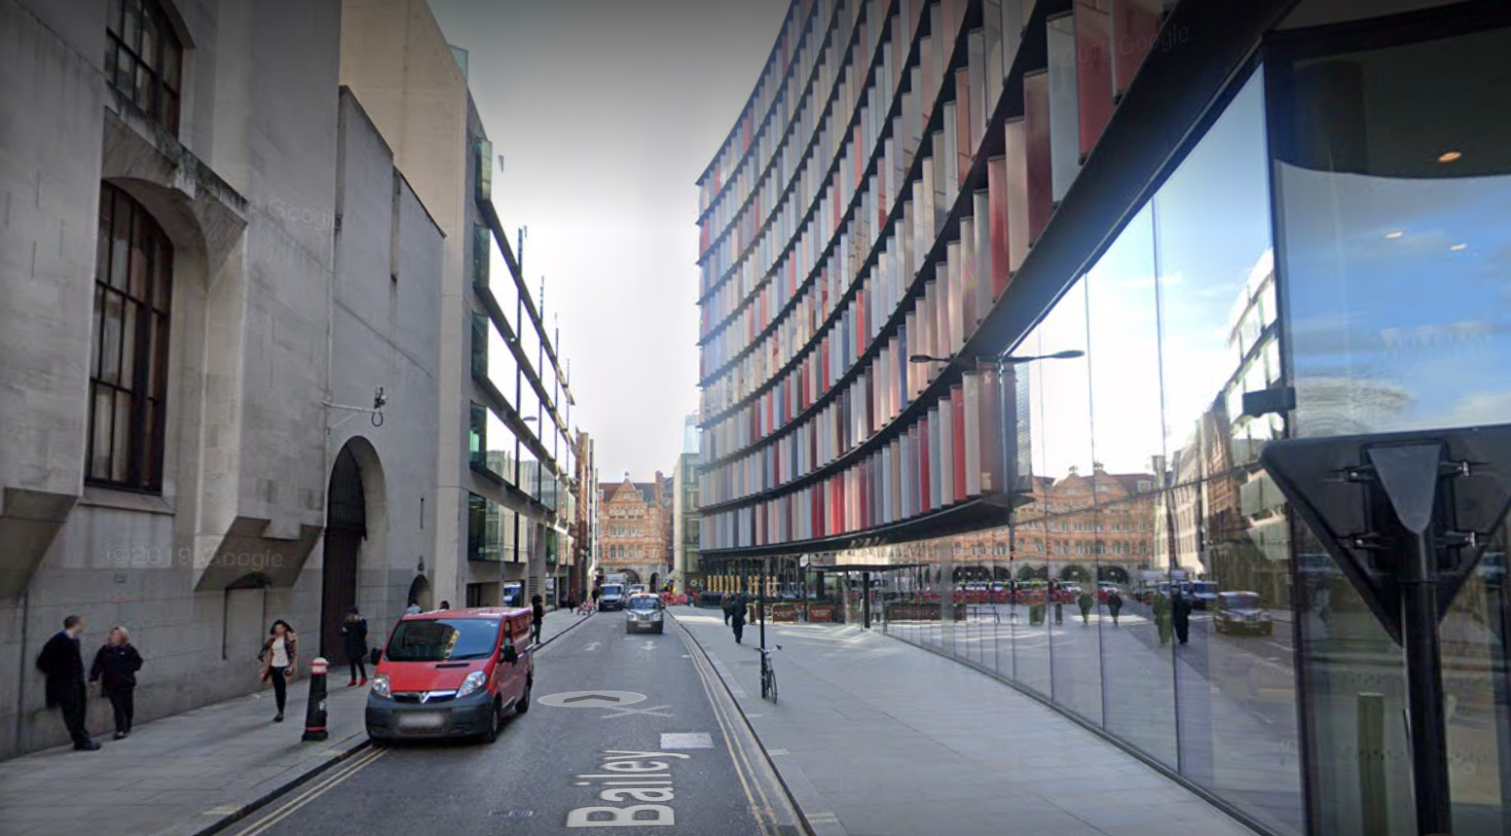
clarifai.com
please upload an image…

Slide 35
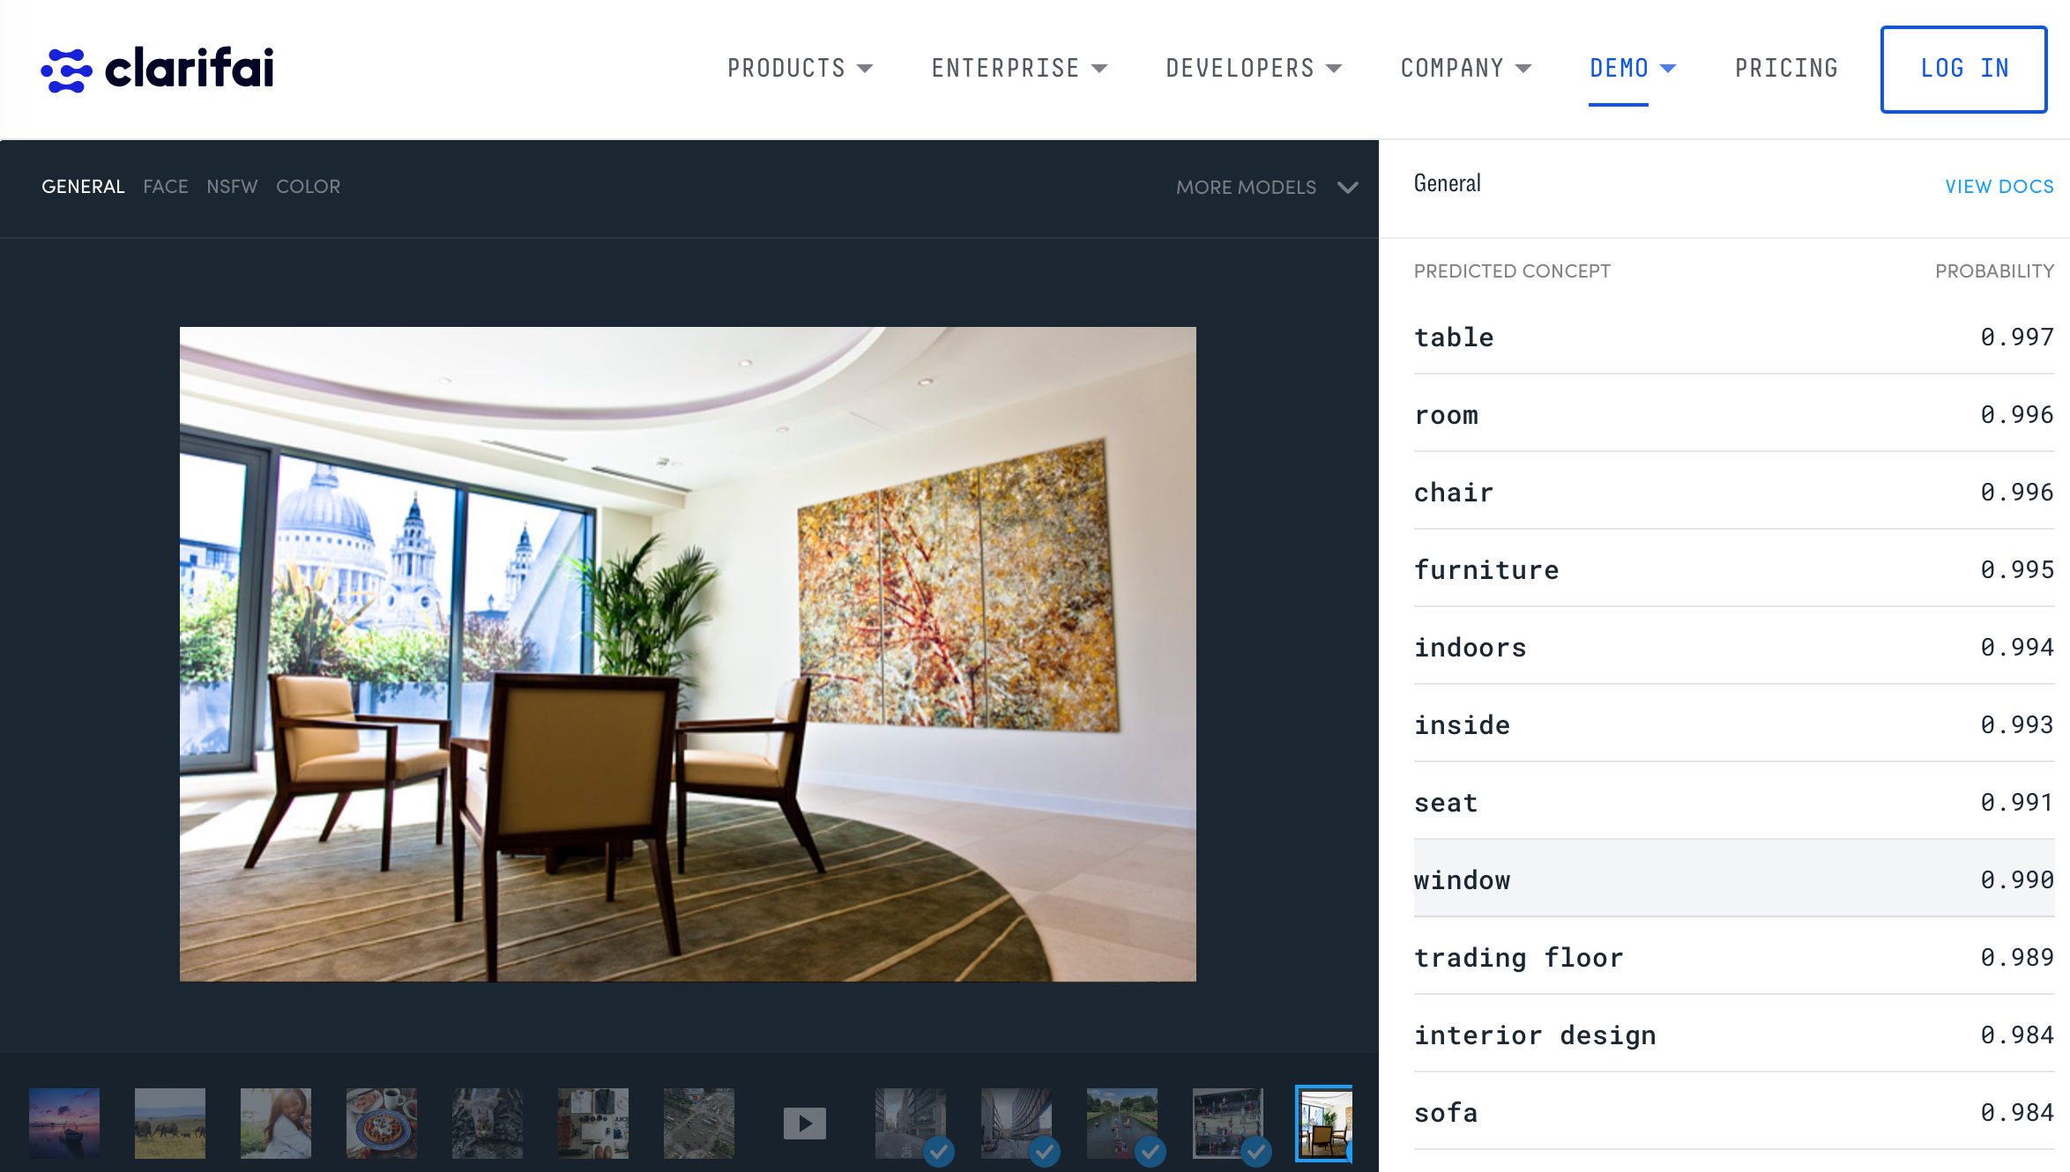
deep learning
is not robust
deep learning is often confidently wrong

Slide 36
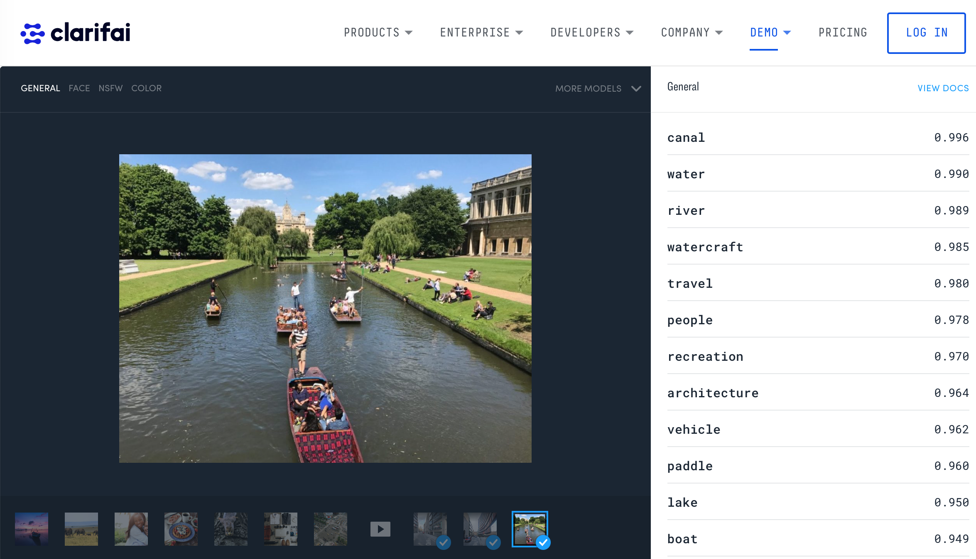
To add ‘punt’ requires:
many labelled images of punts
retraining system from scratch
deep learning is data inefficient and does not support continual learning

